Slide 1
V is for Vegan/Vegetarian
Jolene Wolf, MPH, RD, LD, CDE
Clinical Dietitian
Mary Greeley Medical Center

Slide 2
Vegetarian Diets Continue to Increase in Popularity
3% of Americans are full-time vegetarians
37% say they always or sometimes eat vegetarian when dining out
20% are likely to look for a restaurant which serves some vegetarian items

Slide 3
What is a vegetarian diet?
Lacto-vegetarian – excludes meat, fish, poultry, eggs; includes dairy
Ovo-vegetarian – excludes meat, fish, poultry, dairy; includes eggs
Lacto-ovo vegetarian–excludes meat, fish, poultry;includes dairy, eggs
Pescatarian – excludes meat, poultry, dairy, eggs; includes fish
Vegan – excludes meat, poultry, fish, eggs, dairy, honey
Flexitarian – a semivegetarian diet; primarily plant-based but includes animal products on occasion or in small amounts

Slide 4
Why choose a vegetarian diet?
Health benefits
Weight loss
Religious/moral/ethical reasons
Environmental motivation

Slide 5
Health Benefits
Top reason for choosing vegetarian
Heart health
  Healthier plant-based foods=25% lower chance of heart disease
  Unhealthy plant foods=32% higher chance of heart disease
Diabetes
  Healthy plant foods diet=34% decreased risk of diabetes
  Less healthy plant food diet=16% higher risk of diabetes
  Eating more healthy plant foods while NOT cutting out meat still has benefits for heart health and for avoiding diabetes.

Slide 6

“Twinkie” Vegetarian
Vegan/vegetarian diets are NOT automatically healthy
Limit refined carbs
Emphasize whole grains, whole fruits/vegetables and nuts

Slide 7
Weight Loss
Vegetarian diets don’t automatically result in weight loss
Tend to be lower in calories and higher in fiber=feel full on less cals
Replacing meat with cheese and nuts could even increase calories
Many vegetarians avoid alcohol, caffeine, & tobacco and exercise regularly-helps control weight

Slide 8
Cancer Risk
Processed meat
How you cook your meat
AICR promotes a plant based diet
Phytochemicals
Pooled data from 2 Oxford studies showed fish eaters had a lower risk of certain cancers than vegetarians
Studies comparing caner rates in vegetarians and nonvegetarians have shown inconsistent results

Slide 9
Other Vegetarian Health Factors
Study in JAMA suggests a vegetarian diet may be just as effective as statin drugs in lowering cholesterol
  Was low fat
  Included soy, nuts, margarines with plant sterols, high fiber grains, plenty of fruits and vegetables

Slide 10
Are there downsides to vegetarian diets?
Mood problems?
  No cause and effect link to mental problems and vegetarian diets
Hair loss?
  Meat contains protein, iron, vitamin B and zinc-all important for hair growth

Slide 11
How to Follow a Vegetarian Diet
Choose a variety of healthy plant-based foods
  Whole fruits and vegetables
  Legumes and nuts
  Whole grains
Cut back on less healthy choices
  Sugar sweetened beverages
  Fruit juices
  Refined grains

Slide 12
Healthy Vegetarian Eating Pattern
(servings for a 2000 cal/day diet)
Vegetables | 2-1/2 cups a day
Dark green | 1-1/2 cups a week
Red and orange | 5-1/2 cups a week
Legumes | 1-1/2 cups a week
Starchy | 5 cups a week
Other | 4 cups a week

Slide 13
Grains | 6-1/2 ounces a day
Whole grains | >3-1/2 ounces a day
Refined grains | <3 ounces a day

Slide 14
Protein foods | 3-1/2 ounces a day
Eggs | 3 ounces a week
Legumes | 6 cups a week
Soy products | 7 ounces a week
Nuts and seeds | 8 ounces a week

Slide 15
Fruits | 2 cups a day
Dairy | 3 cups a day
Added sugars, solid fats, added refined starches | No more than 290 calories a day (15% of total calories)

Slide 16
Oils | 27 grams a day

Slide 17
Challenging Nutrients
The more restrictive the diet, the more challenging to get all the nutrients needed
  Vegan diets eliminate natural food sources of B12
  Vegan diets eliminate dairy which contains calcium
Pay special attention to the following nutrients:
  Calcium, vitamin D
  Vitamin B-12
  Protein
  Omega-3 fatty acids
  Iron, zinc, iodine

Slide 18
Calcium and Vitamin D
Calcium helps build/maintain strong teeth and bones
  Milk and dairy foods are highest in calcium
  Dark green vegetables are good plant sources
  Calcium-enriched and fortified products are other options
Vitamin D also plays a role in bone health
  Vitamin D is added to cow’s milk, some brands of soy and rice milk, and some cereals and margarines
  Check food labels
  Low fortified food intake and limited sun exposure=may need plant derived vitamin D supplement

Slide 19
Vitamin B-12
Necessary to produce red blood cells and prevent anemia
Found almost exclusively in animal products
May go undetected because high folate masks deficiency till severe problems occur
Vegans should consider:
  B-12 supplements
  Enriched cereals
  Fortified soy products

Slide 20
Protein
Helps maintain healthy skin, bones, muscles, organs
Eggs and dairy are good sources
Plant foods provide sufficient protein if you eat a variety through day
  Soy products and meat substitutes
  Legumes
  Lentils
  Nuts
  Seeds
  Whole grains

Slide 21
Omega-3 Fatty Acids
Important for heart health
Diets low in fish and eggs are low in active forms of Omega-3 Fas
Canola and soy oils, walnuts, ground flaxseed, soybeans are good sources of essential Fas
Conversion of plant-based Omega-3 is inefficient
Vegans should consider fortified products, supplements, or both

Slide 22
Iron
Iron is a crucial component of RBCs
Sources include legumes, lentils, enriched cereals, whole grains, dark leafy greens, dried fruits
Not as easily absorbed from plant sources
  Recommended intake for vegetarians almost double that of non-vegetarians
  To aid absorption, eat foods rich in vitamin C at the same time
    Strawberries, citrus, tomatoes, cabbage and broccoli

Slide 23
Zinc
Essential component of many enzymes
  Plays a role in cell division
  And formation of proteins
Not as easily absorbed from plant sources
Cheese is a good option if you eat dairy
Plant sources include whole grains, soy, legumes, nuts, wheat germ

Slide 24
Iodine
Component in thyroid hormones
  Help regulate metabolism, growth and function of key organs
Vegans may not get enough
  May be at risk of deficiency and goiter
Foods such as soybeans, cruciferous vegetables and sweet potatoes may promote a goiter
¼ teaspoon of iodized salt per day provides a significant amount of iodine

Slide 25
Common Questions
Do I have to start over totally?
Will changes cost me more?
Will this take more time?
Why do I have to do this?

Slide 26
Tips for Introducing Vegetarian Food Into Institutions
Easiest way to meet needs of different categories of customers is to offer vegan menu items
Start with minor changes to existing menu
Changes should be easy to implement
  Begin with changes that do not involve excessive staff time/training or equipment purchases
Cost of new menu items should be equal to or less than existing
  Potential cost savings of vegetarian options can be a selling point to administrators

Slide 27
Simple Modifications to an Existing Menu
Examine the existing menu
Are there already vegetarian items?
  Baked potatoes
  Salads
  Breads
  Soup (no chicken or beef broth)
  Mac and cheese/meatless lasagna/pizza
Indicate by a special marking on the menu, an info card at POS, or by posting a separate vegetarian menu

Slide 28
Simple Modifications to an Existing Menu
Make a vegetarian soup a daily menu item
Offer a meatless prepared salad (bean or grain) every day
Consider adding a salad bar
Offer cooked pasta or a baked potato every day
If a selection of hot entrees is offered each day, make one of them meatless
Have nondairy milks available
Keep a good supply of fresh fruit available at all times

Slide 29
Simple Modification of Existing Recipes
Many soups can be made vegetarian by changing from meat-based stock to a vegetable stock.
Replace meat stock with vegetable stock in pilaf, other grain dishes, sauces
Lasagna can be prepared with a meatless sauce with vegetable subs
When preparing spaghetti or pasta sauce, prepare part w/o meat
Use vegetable oil instead of animal fat for frying/sautéing
Prepare or purchase baked goods with vegetable instead of animal fat

Slide 30
Simple Modifications of Existing Recipes
Prepare or purchase yeast breads without eggs or dairy
Milk can be replaced with soy milk, rice milk, or with water in most recipes
Buttermilk can be replaced with soured soy milk or rice milk (use 1 cup soy milk plus 1 Tbsp of vinegar)
Crumbled tofu can be substituted for cottage cheese or ricotta cheese in recipes
Offer vegetarian beans, chili beans, refried beans w/o lard

Slide 31
Simple Modifications of Existing Recipes
Over 60 varieties of nonmeat burger patties exist to sub for hamburgers
Vegetarian hot dogs are also available
To produce a chewier, meatier tofu, freeze it for 3 days, thaw, squeeze out water, and crumble
Add bulgur to the beans in tacos, chili, etc. if you want less beans
See handout for more tips

Slide 32
Typical Entrees with Vegetarian Alternatives
Chicken fajitas/Tofu fajitas (use Lawry’s Fajita Seasoning)
Beef or chicken tacos/Bean or Bean and Nut-Seed tacos
Spaghetti with meat sauce/Spaghetti with marinara sauce
Lean beef or chicken patty on bun/ADM Burger patties (dry mix)
Chicken gyros with Tzatziki sauce in pita/ADM taco filling in pita with sauce
Ground beef or turkey lasagna/lasagna with meatless sauce
Stromboli sandwich with turkey, ham, mozzarella/Vegetable Stromboli sandwich with mozzarella, sliced tomato, sliced black olives
Beef and cheese egg rolls/La Choy vegetable egg rolls with almonds (these are vegan)

Slide 33
Breakfast Substitutions
Eggs – scrambled tofu
  Crumble tofu, add spices, turmeric or curry for color
Pancakes
  Use soy milk or water in place of dairy milk
  If you eliminate eggs, increase the baking powder and add lemon jc or vinegar
French Toast – blend soy milk and banana to use as dipping batter
Cold Cereal
Hot Cereal

Slide 34
Breakfast Substitutions
Polenta – Fry on a griddle, serve with applesauce
Juices
Bread
  Be sure ingredients don’t list animal fat
  If catering to vegans, no eggs, whey, casein or other dairy products
Bagels – serve with jam or bananas instead of cream cheese
Fresh fruit

Slide 35
Quantity Recipes
Vegan in Volume by Nancy Berkhoff
https://www.vrg.org/catalog/index.php?main_page=product_info&cPath=1&products_id=10

Slide 36

Fast, Lower Budget Vegan Menu Items
Three-Bean Tamale Pie
Alternate three types of cooked beans with salsa, top with prepared vegan cornbread mix, and bake. Optionally, substitute mashed potatoes for the cornbread.

Slide 37
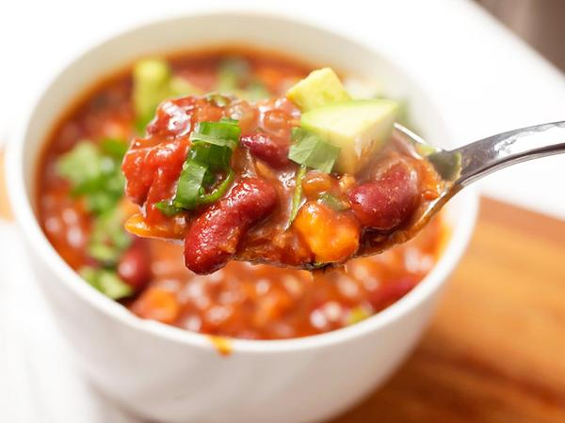
Chili Sauté
Add chopped bell peppers, onions, and garlic to three or four bean chili and sauté or bake. Serve over steamed rice, vegetarian cornbread, or mashed potatoes.

Slide 38
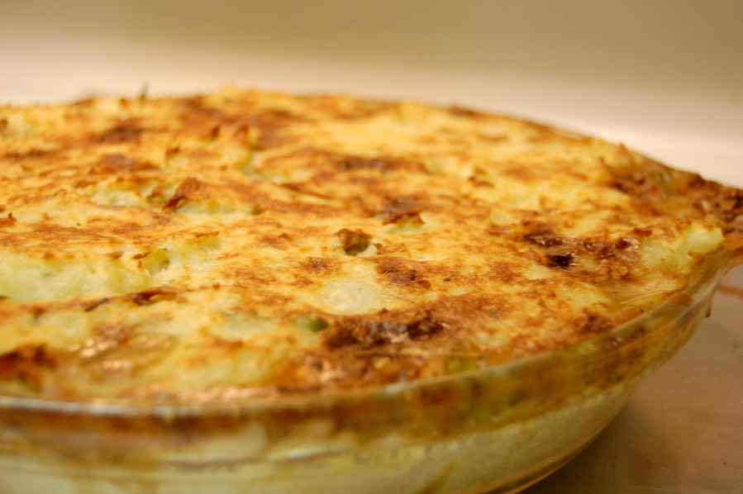
Veggie Shepherd’s Pie
Top vegetable stew – a mix of carrots, celery, onions, and mushrooms or mixed vegetables combined with cooked beans – with prepared mashed potatoes and bake.

Slide 39
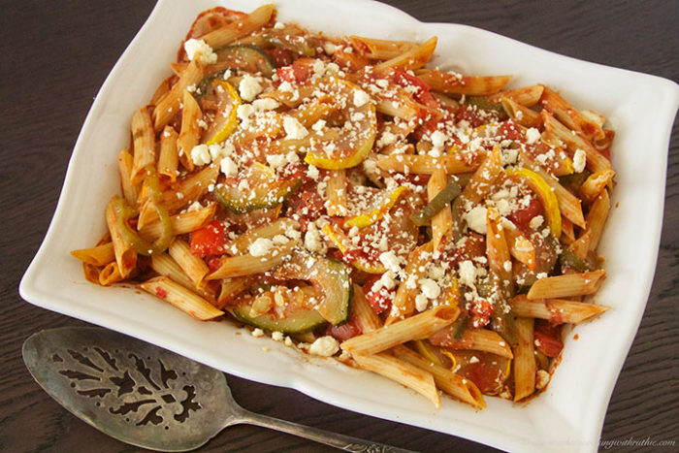
Pasta Bake
Combine cooked pasta with tomato sauce, chopped tomatoes, and diced mushrooms. Season with ground basil and oregano and bake.

Slide 40
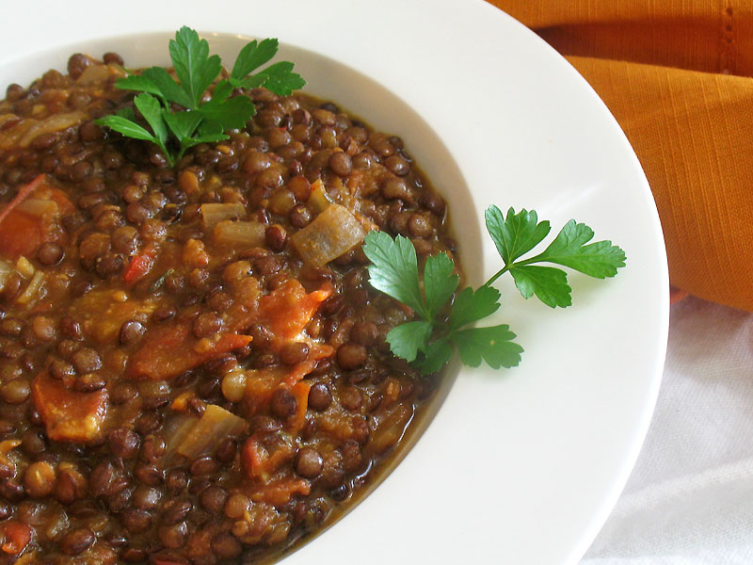
Lentil Stew
Combine cooked lentils with cooked, quartered steamed potatoes; cooked carrot slices; diced celery; and chopped tomatoes. Season with pepper and dill, and simmer until ready to serve.

Slide 41
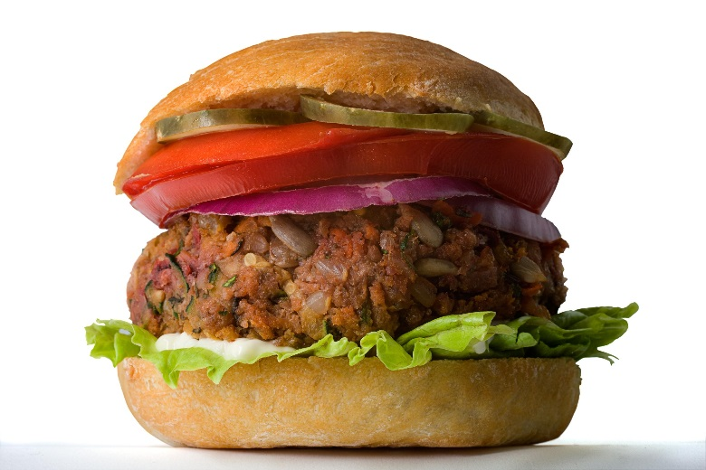
Veggie-Size
Serve veggie burgers topped with vegetarian chili and chopped veggies. Serve on a hamburger bun or toasted bread.

Slide 42
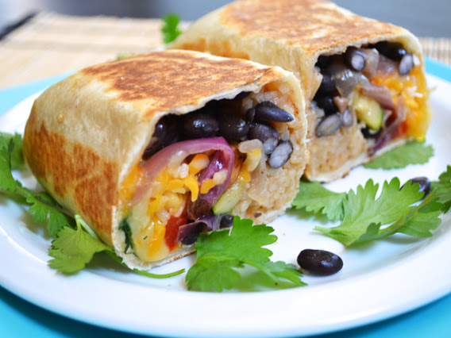
Burrito Wrap
Fill a large tortilla with mashed beans, sliced chilies, chopped tomatoes or salsa, and sliced onions. Heat in the oven or microwave and serve hot.

Slide 43
References
Mayoclinic.org
Webmd.com
Vrg.org
Eatright.org
Health.Harvard.edu
MD Anderson Cancer Center
Dietary Guidelines for Americans

