Slide 1


Update
Experts in foodservice management and food safety

Slide 2



Regulatory

Slide 3
Regulatory
  CDM Day of the Year – November 28, 2023
  NEW ANFP Regulatory and Compliance webpage
  2022 FDA Food Code
  Government Affairs Committee
    Brand Ambassador Guide and Tool Kit

Slide 4
Legislative

Slide 5
Legislative
  Opportunity America Jobs and Careers Coalition
  ANFP Apprenticeship Program
  Status of CMS Regs §483.60–Food and Nutrition Services

Slide 6


Government Affairs GrassROOTS Initiative
Rallying Organizations & Officials in Training Standards
Cultivate, Grow, REAP!
ANFP-PAC Contributes to U.S. Senator Bill Cassidy

Slide 7
Certification

Slide 8

Certification
74%
First-Time Test Takers Passing Rate

Slide 9
Certification
CDM, CFPP Scope of Practice
www.CBDMonline.org/scope

Slide 10

Continuing Competence Initiative
Certification
Embraces demonstrating knowledge, skills or abilities as we progress throughout our careers
Competence means delivering best practice results
Greater credibility with employers, surveyors, colleagues
Encourages looking at our own professional development goals and choosing the right CE to support those needs

Slide 11
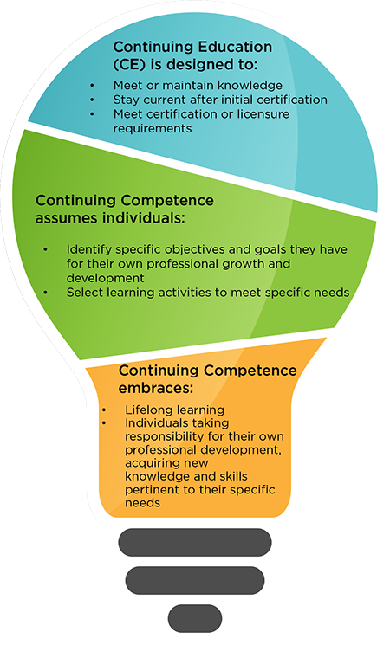
Certification
The Continuing Competence Initiative formally begins on June 1, 2023. Participation in the initiative has a rolling start date, to coordinate with your recertification cycle:
Three-Year Recertification Cycle | Start Date
June 1, 2023 – May 31, 2026 | June 1, 2023
June 1, 2024 – May 31, 2027 | June 1, 2024
June 1, 2025 – May 31, 2028 | June 1, 2025

Slide 12
Strategic Plan
Update

Slide 13
Strategic Plan
VISION
The Certified Dietary Manager is the cornerstone of the collaborative food and nutrition profession.
MISSION
Position the CDM, CFPP as the expert in Foodservice Management and Food Safety.

Slide 14
Strategic Plan
GOAL 1:
The CDM, CFPP is a required staffing qualification in non-commercial foodservice management.
GOAL 2:
CDM, CFPPs maintain continued professional competence.
GOAL 3:
ANFP is a source for foodservice management and food safety data.
GOAL 4:
The future of the food and nutrition profession is secured through increased member engagement.

Slide 15
Professional Development

Slide 16
Professional Development
New for 2023!
New Recertification Bundle Released February 2023
45 hours
Covers all 5 domains
Meets sanitation and ethics requirements
Updated online course look and feel
More learning interactions
Easier navigation
Better user experience

Slide 17

Professional Development
Learn and Save EVERY Month!
Check out the Discounted CE special page on website for the latest monthly CE specials, free CE opportunities, and the newest offerings to meet your professional development goals.

Slide 18
Membership

Slide 19



Membership
ANFPtv is a member benefit you won’t want to miss!
ANFPtv is a portal within the ANFP website that brings viewers like you fresh, engaging, and educational video content, organized by topic area.
Content ranges from customized education to conference recaps, and much more.

Slide 20



Membership
New Member Onboarding & Retention
Pride in Foodservice Week
Takes place each February
Member Appreciation Week
Takes place each April
Volunteer Appreciation Week
Takes place each Fall

Slide 21




Membership

Slide 22



Membership

Slide 23



Membership
Member Discount Program

Slide 24




Member Recognition
Awards & Recognition
ACE Awards
Open to all members
CDM Recognition
CDM of the Month, Meet a Member, Career Reflections, My Recipe for Success
Chapter Awards
Communication, government affairs, membership, state achievement and Diamond awards
Member Longevity Program
ANFP members are recognized for the longevity of their membership

Slide 25

LIG Insurance Program
Health Insurance and coverage options include:
Major medical
Medicare
Short-term health plans
Vision & Dental plans
Critical care coverage & disability
LIG Rx Pharmacy Program & more...

Slide 26
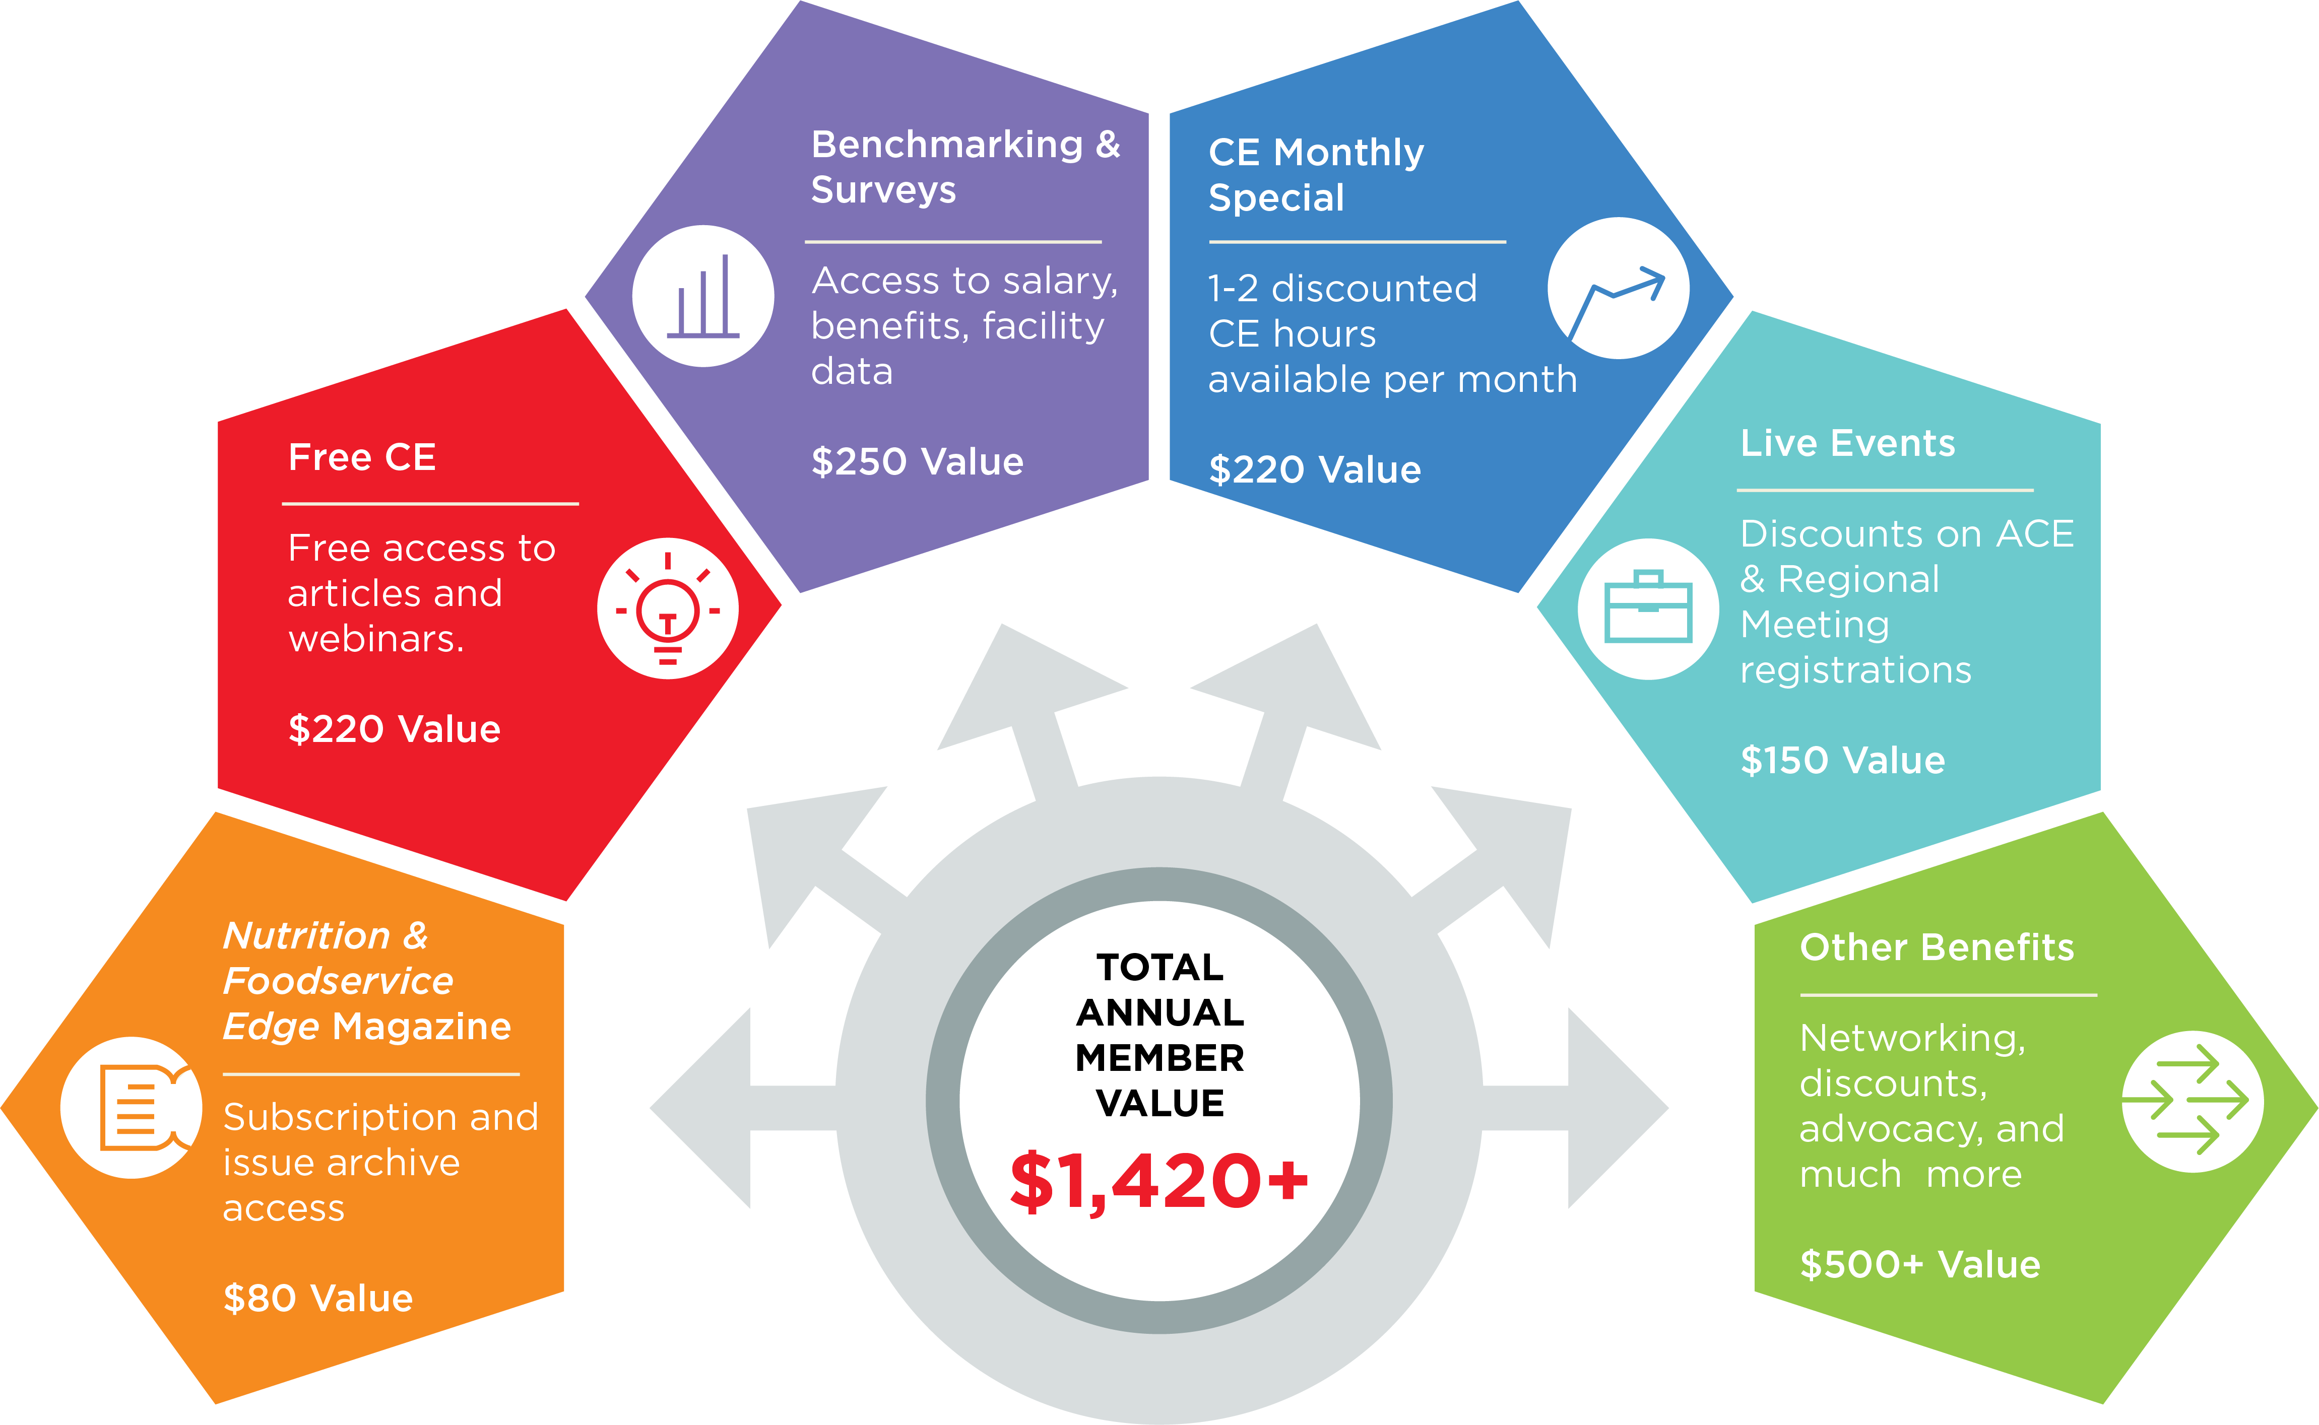
Member Value Infographic

Slide 27
Nutrition & Foodservice Education Foundation (NFEF)

Slide 28


NFEF
Chapter Champions

Slide 29

NFEF
Grants

Slide 30





NFEF
Corporate Partners and Ways to Support
Visionary Level $5,000 -$9,999

Slide 31

Thank You
Phone
800.323.1908
E-mail
info@ANFPonline.org
Website
www.ANFPonline.org

