Slide 1


Update
Experts in foodservice management and food safety

Slide 2



Regulatory

Slide 3
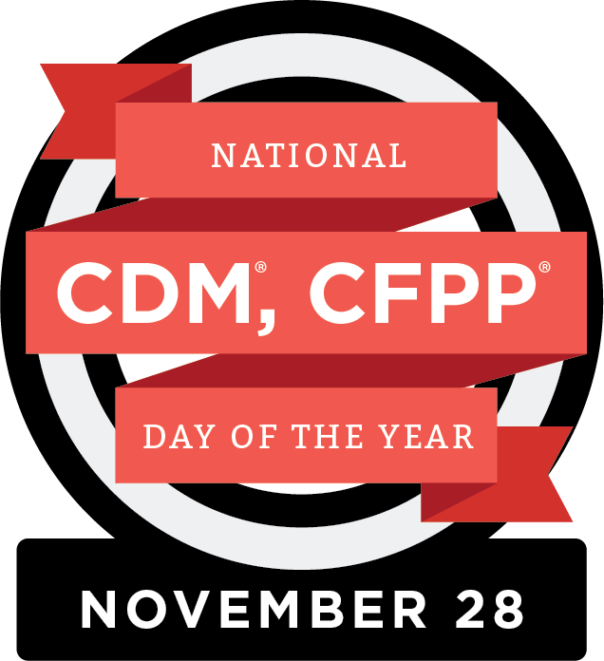
Regulatory
CDM, CFPP Day of the Year – November 28, 2024

Slide 4
Legislative

Slide 5
Legislative
Executive Orders
Workforce Development
Workforce Innovation and Opportunity Act
Apprenticeship Programs
ANFP-PAC

Slide 6


GrassROOTS Campaign
Rallying Organizations & Officials in Training Standards
Ways to Support ANFP-PAC

Slide 7
CBDM Certification Program

Slide 8

Certification
70%
First-Time Test Takers Passing Rate

Slide 9
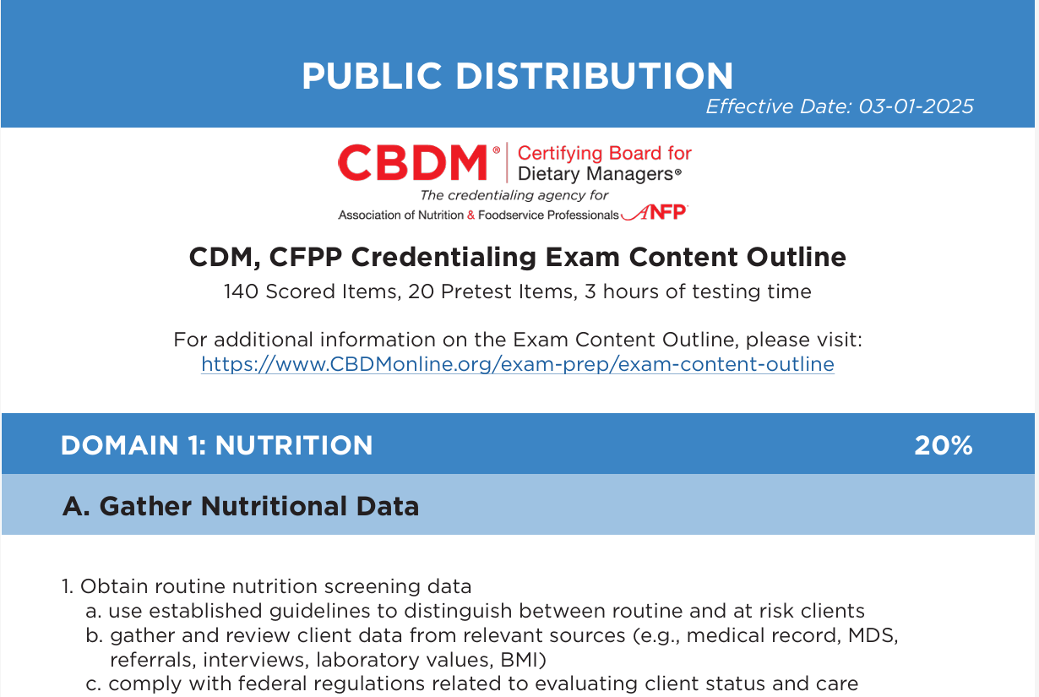
Certification
CDM,CFPP Credentialing Exam Content Outline
www.cbdmonline.org/exam-prep/exam-content-outline

Slide 10

Certification
NCCA Update
CBDM Certification Program accredited by third party accrediting body since 1989
Met reaccreditation standards for another five years, in November 2024
NCCA accreditation assures stakeholders that the CDM, CFPP credential is valid, reliable, and grounded in best practices

Slide 11

Continuing Competence Initiative
Certification
Embraces demonstrating knowledge, skills or abilities as we progress throughout our careers
Competence means delivering best practice results
Greater credibility with employers, surveyors, colleagues
Encourages looking at our own professional development goals and choosing the right CE to support those needs

Slide 12
Certification
CE Audit Update
CDM, CFPPs whose three-year recertification cycle ends on May 31 and have not submitted any CE hours, will have their certification terminated, and will need to retest to become certified again.
CDM, CFPPs with more than 0.5 CE but less than 45.0 CE on May 31of the third year of their recertification cycle, will be automatically placed into CE Audit to remain certified.
All recertification and CE Audit requirements will need to be met to pass the CE Audit

Slide 13
Strategic Plan Update

Slide 14
Strategic Plan
ANFP Vision
Enhance health and wellness through optimum nutritional care.
ANFP Mission
Build an inclusive and diverse community of experts in foodservice management and food safety through:
Education
Advocacy
Research

Slide 15
Strategic Plan
GOAL 1:
Members and prospective members find value, community, and support at the local, state, and national level, resulting in an engaged and growing membership.
GOAL 2:
CDM, CFPPs are recognized as the experts in foodservice management and food safety. The credential is required in regulations and supported by employers and other stakeholders.
GOAL 3:
ANFP is a leader in creating and curating resources to elevate the food and nutrition industry.
GOAL 4:
ANFP is a leader in innovation and continuously evolves to meet the needs of its stakeholders and members.
GOAL 5:
ANFP, as an organization and community, organically fosters a safe environment of diversity, equity and inclusion through the actions of members and stakeholders.

Slide 16
Professional Development

Slide 17

Professional Development – What's New?
Online Course -
Effective Networking
In today's competitive professional landscape, your network is often your greatest asset.
This course is designed to equip you with the essential tools and strategies to cultivate a thriving professional network. We will delve into the art and science of networking, exploring everything from initial introductions to long-term relationship building.
WORTH 1.5 CE
Notes:
This new online course offered by ANFP provides the "why" and "how" to networking. Listen to short videos from a live event session at ACE 2024, to learn skills and strategies to cultivate a thriving professional network.

Slide 18
Professional Development – What's New?
Power and Pride: The Origins of Pride and Beyond
This course is focuses on:
An understanding of how Pride came to be, the significant historical events that have shaped Pride as we know it today.
How do we remain authentic supporters of LGBTQ+ rights and honor the community.
WORTH 1 ETHICS CE
Notes:
ANFP is dedicated to celebrating diversity, equity and inclusion and is proud to recognize the past, present and future of Pride. ANFP is proud to offer this course to focus on historical events that have shaped pride and how to remain authentic supporters of LGBTQ+ rights.

Slide 19
Professional Development
New Textbooks
Foodservice Management – By Design, 4th Edition
Nutrition Fundamentals and Medical Nutrition Therapy, 4 Edition
New Study Materials
Flashcards – Hard Copy/Online
Math Workbook – Hard Copy/Online
Online Review Course – Online
Study Guide – Hard Copy
PSI Self-Assessment Exam- Online
Notes:
A new exam content outline became effective March 1, 2025. With the new outline, new textbook editions and study materials are now available to reflect the new outline. This includes the 4th edition of Foodservice Management – By Design, and Nutrition Fundamentals and Medical Nutrition Therapy. Also available are exam study preparation material with options in hard copy and online.
If you know a student preparing for the exam, direct them to the ANFP marketplace to view options.
Even if you are a seasoned CDM, CFPP, the latest edition of the textbooks offer a great resource on the latest FDA Food Code and nutrition-related research to keep you updated and relevant in the field.

Slide 20

Professional Development
Learn and Save EVERY Month!
Check out the Discounted CE special page on website for the latest monthly CE specials, free CE opportunities, and the newest offerings to meet your professional development goals.
Notes:
Same

Slide 21
Membership

Slide 22



Membership
ANFPtv is a member benefit you won’t want to miss!
ANFPtv is a portal within the ANFP website that brings viewers like you fresh, engaging, and educational video content, organized by topic area.
Content ranges from customized education to conference recaps, and much more.

Slide 23



Membership
Recognition Celebrations
Pride in Foodservice Week
Takes place each February
Member Appreciation Week
Takes place each April
Volunteer Appreciation Week
Takes place each Fall
National CDM, CFPP Day of the Year
Takes place each November 28

Slide 24




Membership

Slide 25
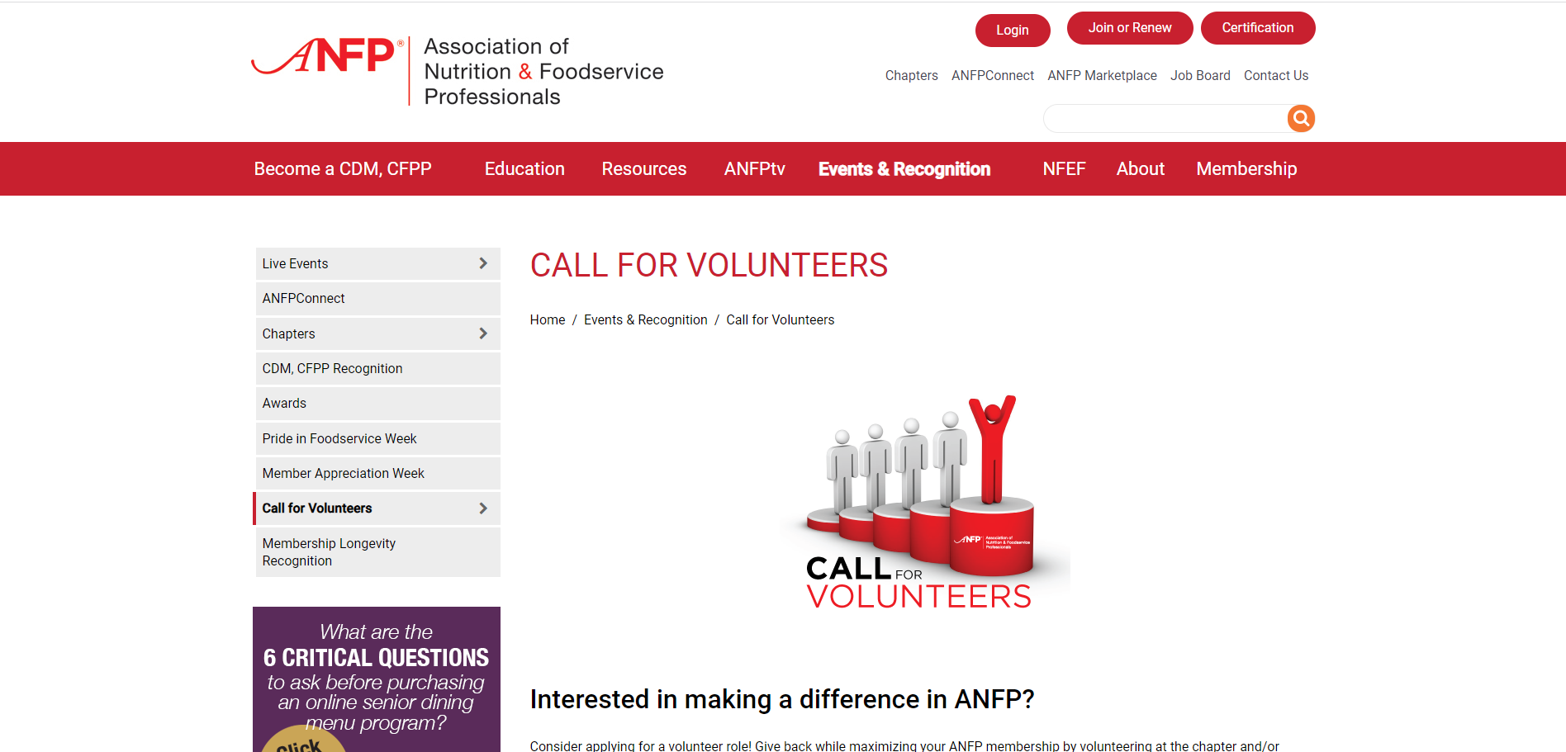
Membership
National & Chapter Volunteers

Slide 26

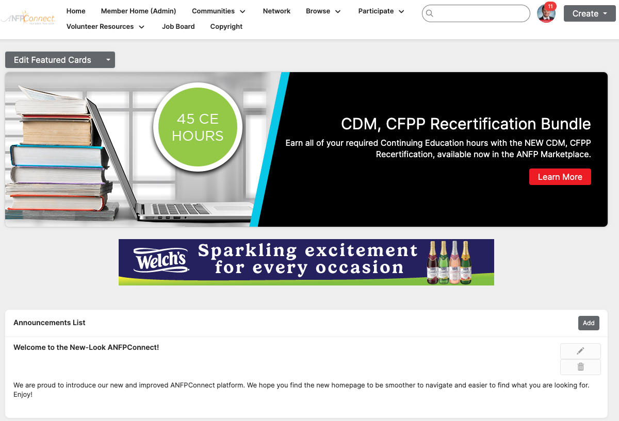

Membership

Slide 27



Membership
Member Discount Program

Slide 28




Member Recognition
Awards & Recognition
ACE Awards
Open to all members
CDM Recognition
CDM of the Month, Meet a Member, Career Reflections, My Recipe for Success
Chapter Awards
Communication, government affairs, membership, state achievement and Diamond awards
Member Longevity Program
ANFP members are recognized for the longevity of their membership

Slide 29

LIG Insurance Program
Health Insurance and coverage options include:
Major medical
Medicare
Short-term health plans
Vision & Dental plans
Critical care coverage & disability
LIG Rx Pharmacy Program & more...

Slide 30
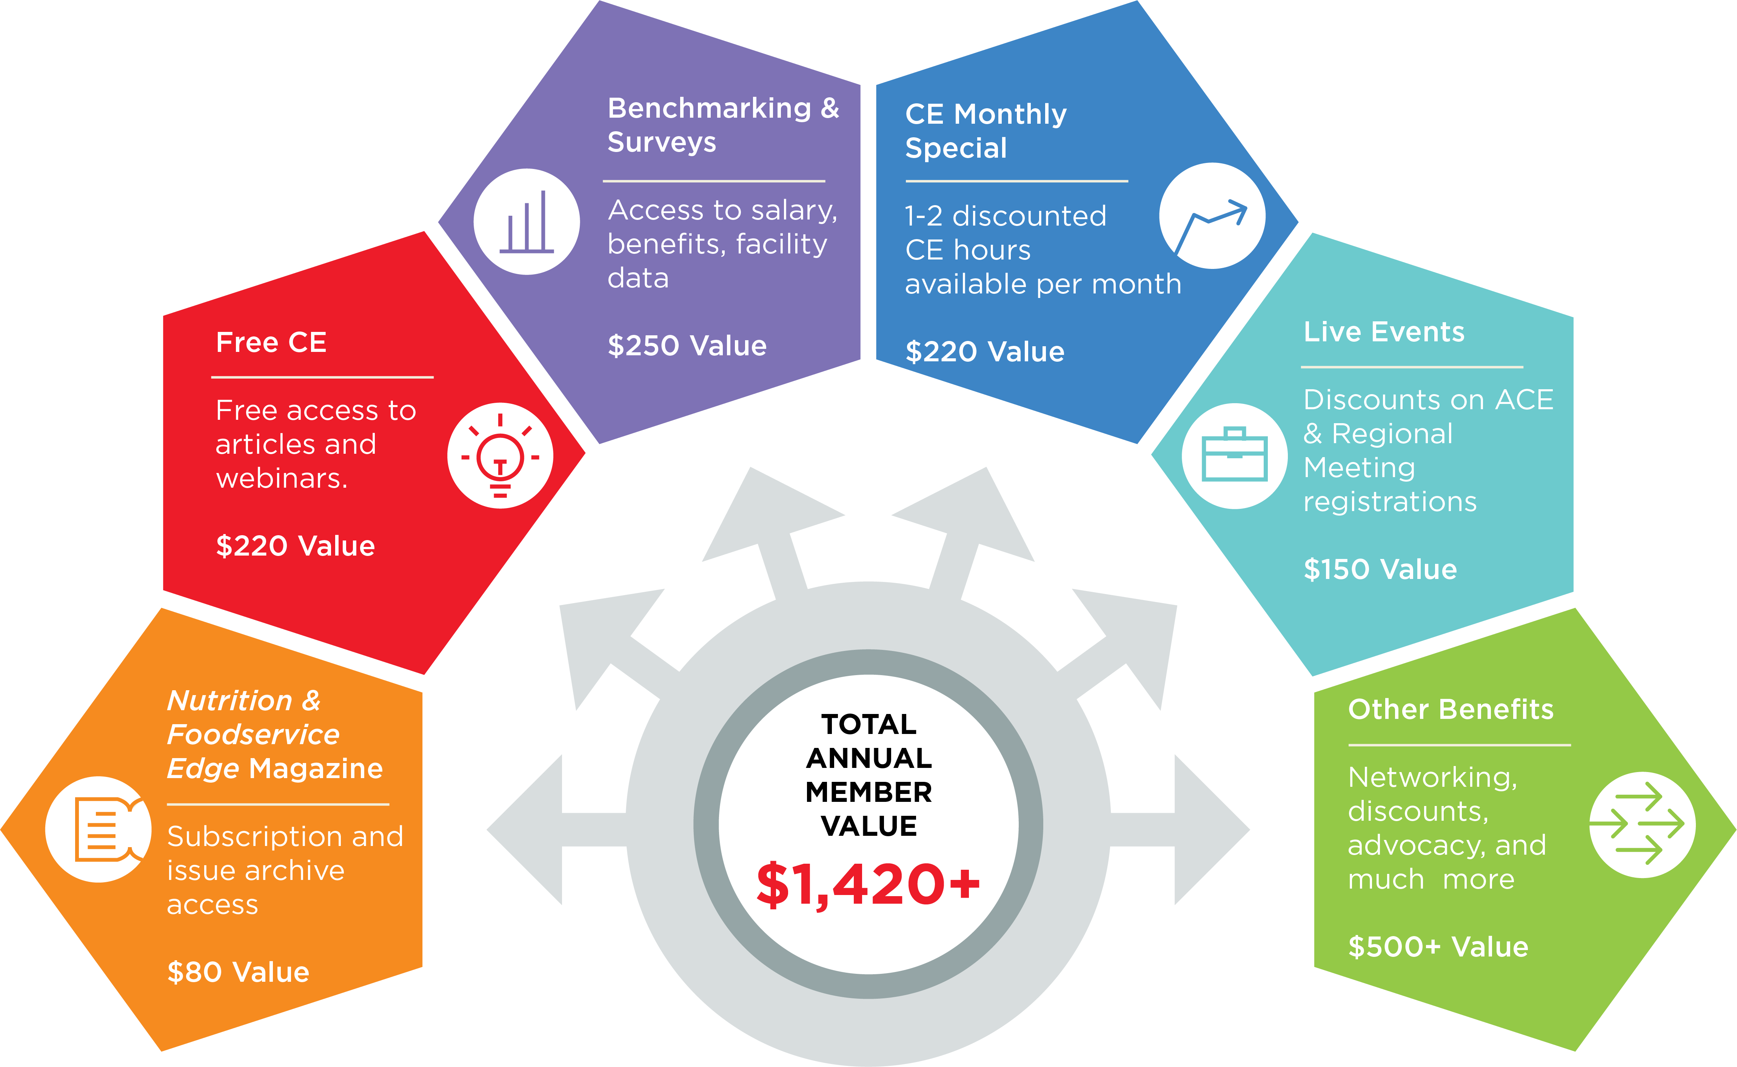
Member Value Infographic

Slide 31
Nutrition & Foodservice Education Foundation
NFEF

Slide 32


NFEF
Chapter Champion Program & NFEF Awards

Slide 33

NFEF
Grants Awarded & Donations Received

Slide 34

NFEF
NFEF News

Slide 35







NFEF
Corporate Sponsors & Ways to Support
Visionary Level $5,000 - $9,999
Patron Level $1,000 - $4,999

Slide 36

Thank You
Phone
800.323.1908
E-mail
info@ANFPonline.org
Website
www.ANFPonline.org

