Slide 1
Updates

Slide 2
ANFP Mission & Vision
Mission
Build an inclusive community of experts in foodservice management and safety through:
Education
Advocacy
Research
Vision
Enhance health and wellness through optimum nutritional care.

Slide 3
ANFP Strategic Plan

Slide 4
GOAL 1
Members
GOAL 4
Innovation
Members and prospective members find value, community, and support at the local, state, and national level, resulting in an engaged and growing membership.
ANFP is a leader in innovation and continuously evolves to meet the needs of its stakeholders and members.
GOAL 2
Credential
GOAL 5
DE&I
CDM, CFPPs are recognized as the experts in foodservice management and food safety. The credential is required in regulations and supported by employers and other stakeholders.
ANFP, as an organization and community, organically fosters a safe environment of diversity, equity and inclusion through the actions of members and stakeholders.
GOAL 3
Education & Expertise
ANFP is a leader in creating and curating resources to elevate the food and nutrition industry

Slide 5
ANFP Member Benefits

Slide 6
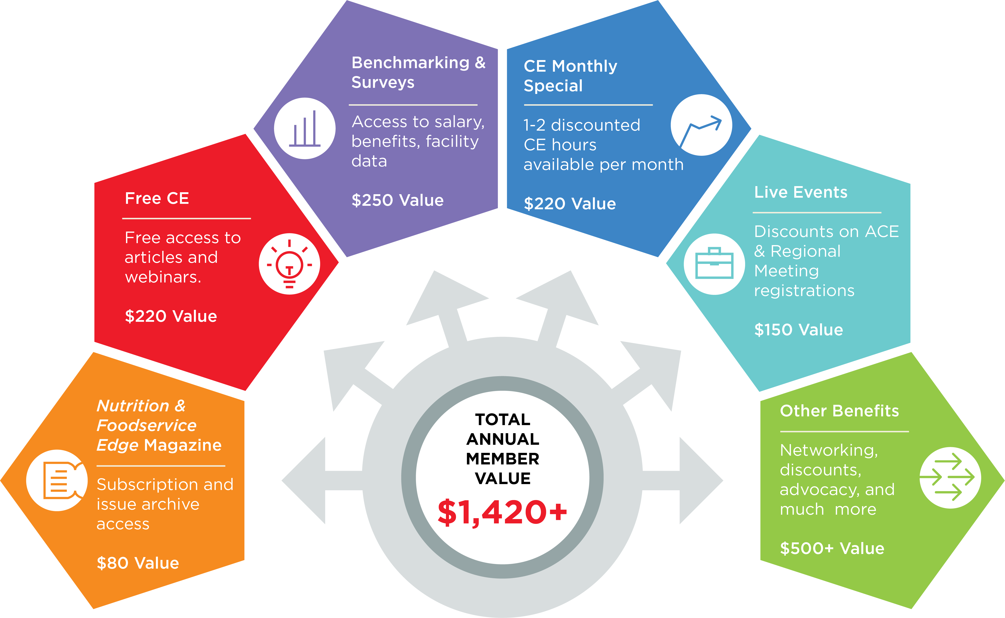
Member Value

Slide 7





Chapter Membership
ANFP Community
Live Events
ANFPConnect
Advocacy

Slide 8




Professional Development
Edge Magazine
Edge Express
Free & Discounted CE

Slide 9





Job Board
Online Resources
Compensation Survey
Member Record & Verify Credentials
Member Discount Program

Slide 10




Recognition
Pride in Foodservice Week
Member Appreciation Week
Recognition Features

Slide 11
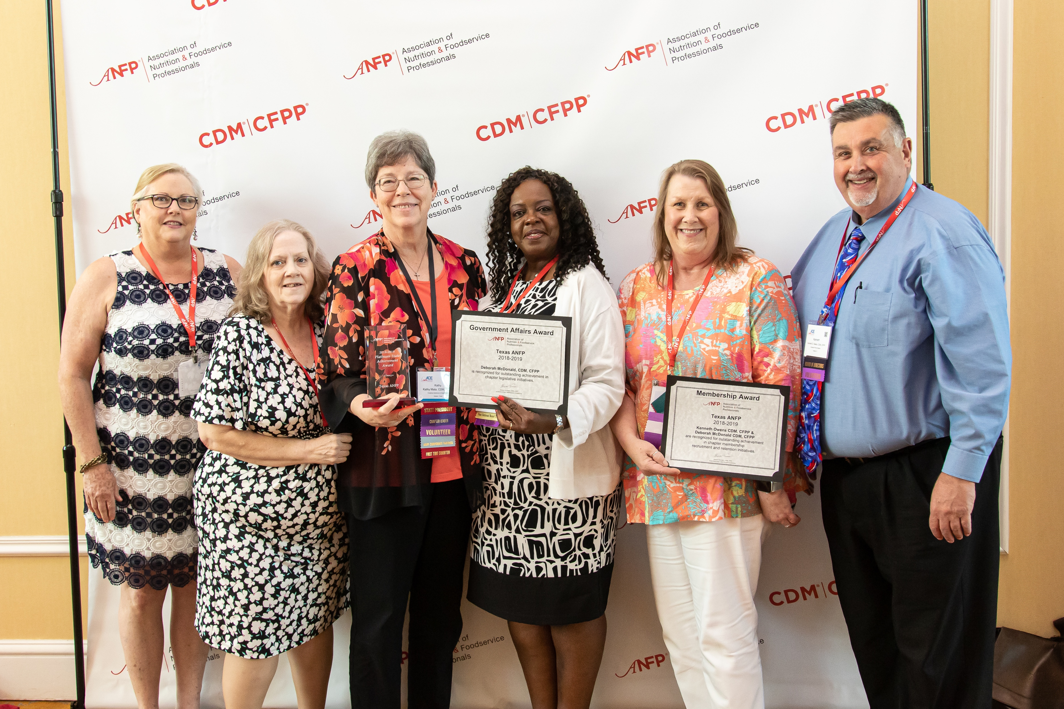
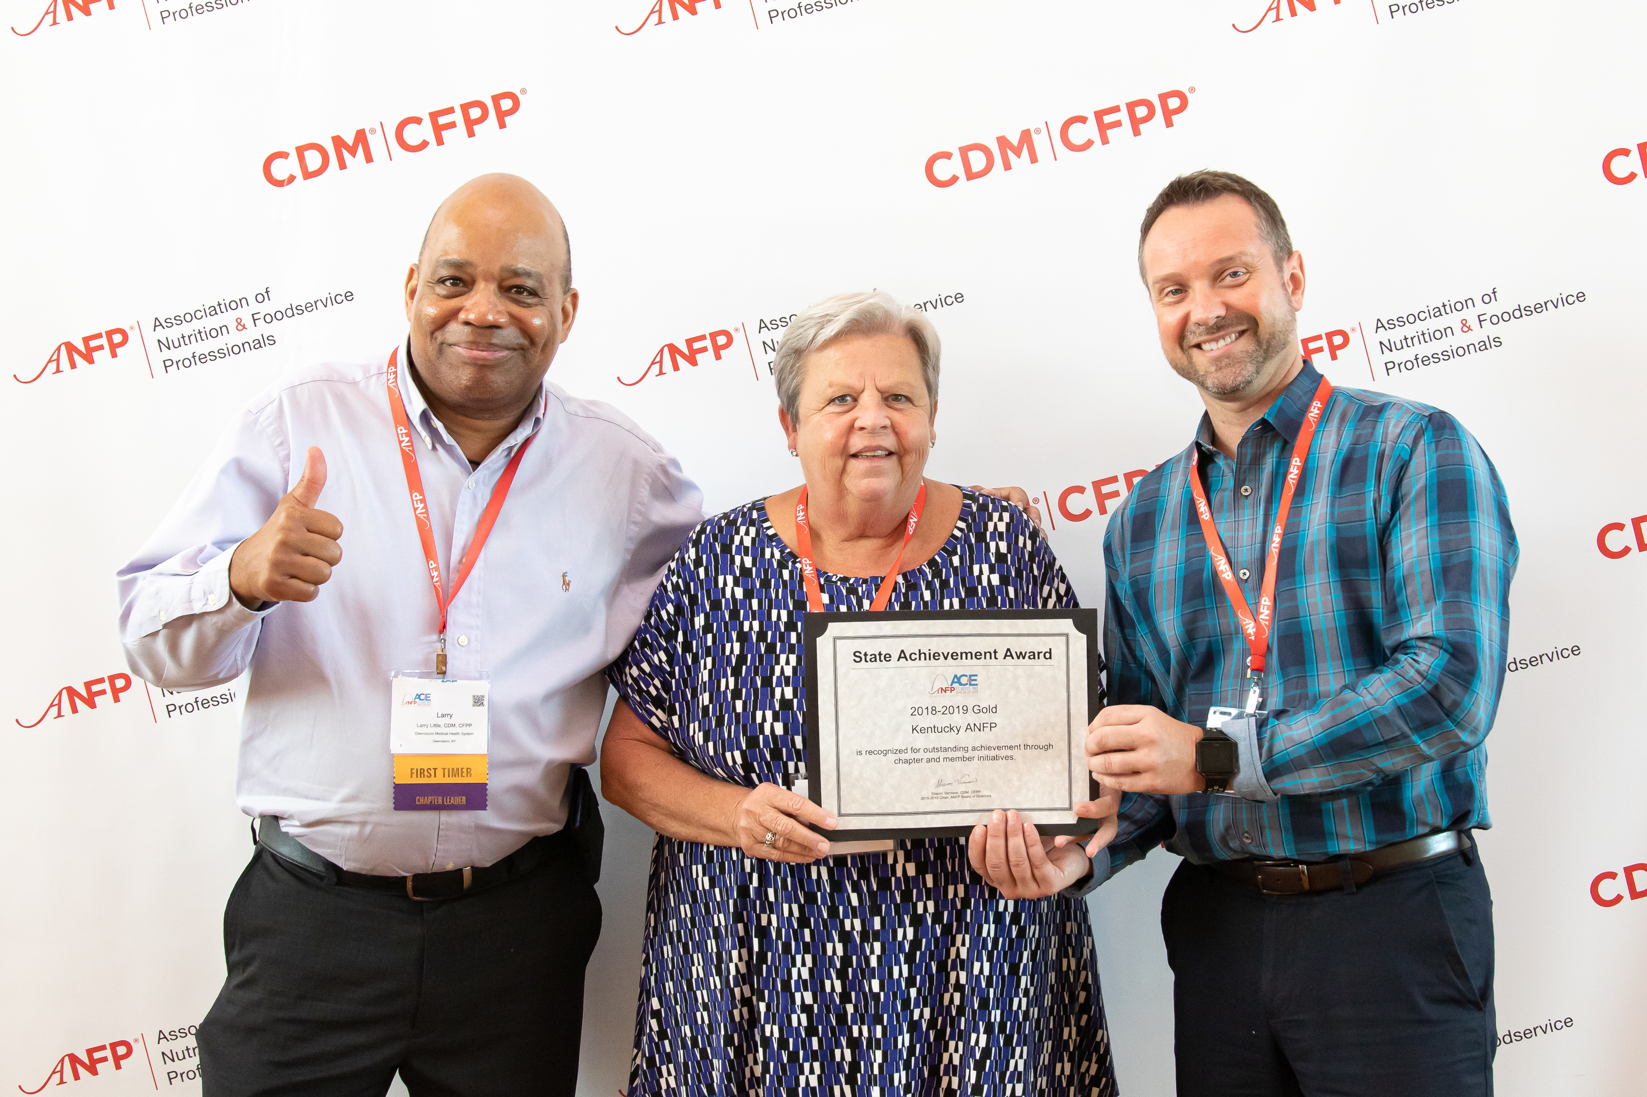
Chapter Membership
Free with ANFP membership
Individual chapter webpages
State meetings

Slide 12


Live Events
Annual Conference & Expo (ACE)
Two Regional Meetings – spring and fall
Earn CE
Attend Expo
ANFP members receive discounted registration fees vs. non-members

Slide 13

Online member community
No cost to members
14,000+ registered users
Thousands of discussion posts and shared documents
Learn from peers and industry experts
Provide tips and advice to those seeking information

Slide 14
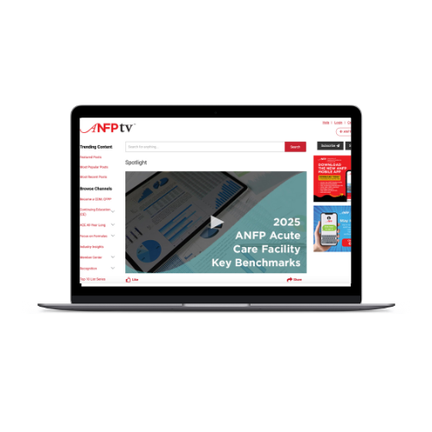
ANFPtv
Member Tutorials
Focus on Formulas
CDM, CFPP Recognition
Industry Insights
Educational Webinars
Edge CE Articles
And much more...

Slide 15


Nutrition & Foodservice Edge Magazine
Six issues per year
FREE with ANFP membership
Digital format with FREE opt-in print subscription

Slide 16
Edge Express
Six issues per year
Published in off months of Edge
Includes a CE article and industry news

Slide 17
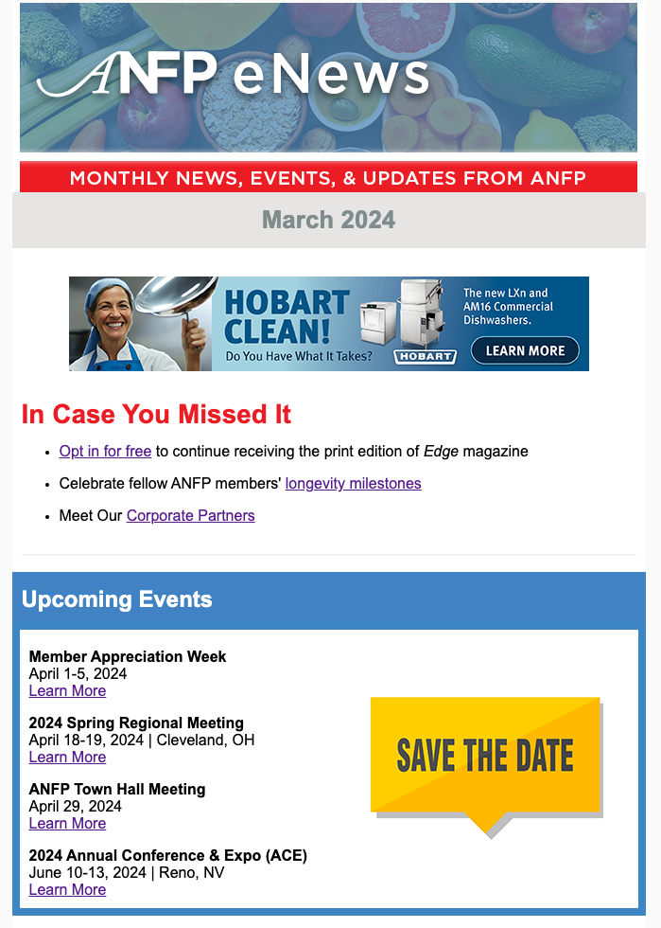
eNews
Discounted CE opportunities list
Upcoming events
Organization & industry news
Membership, certification, & Foundation updates

Slide 18

CE Discounts
20% discount vs. non-members on all CE products
CE Monthly Special – 20% off up to three products each month

Slide 19

Free CE
Member Appreciation Week
Benchmarking survey participation
Sponsored webinars, online courses, and CE article

Slide 20
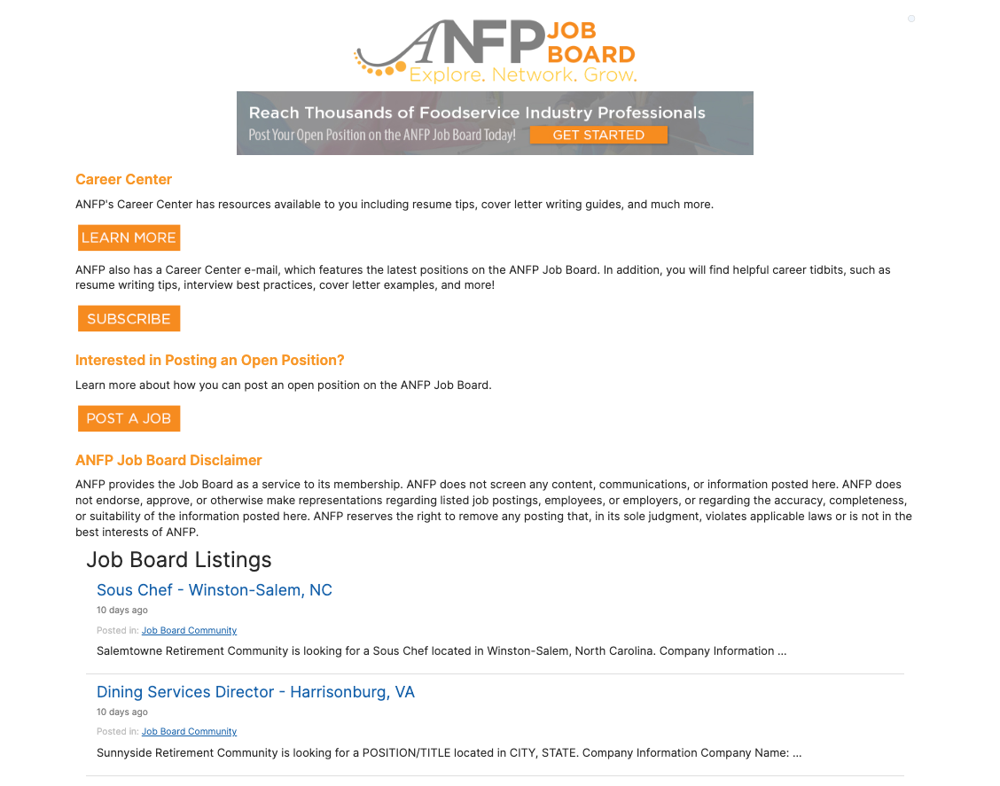
ANFP Job Board
Located on ANFPConnect
View open positions
Post open positions
ANFP members pay $59 to post an open position vs. $89 for non-members

Slide 21

Compensation & Benefits Survey
Free to ANFP Members, $199 for non-members
Full survey was last done in 2022 and is done every four years
Full survey includes:
Salary data for key positions by location, staff size, demographics, and budget
Benefit data
Other benchmarks
Mini-salary survey update is conducted annually to get new data on salaries for key positions

Slide 22
Member Record
View CE transactions
Access and pay member dues invoice
View grants & scholarships
Verify their CDM, CFPP credential
View CE submissions
Report CE and view transcripts

Slide 23
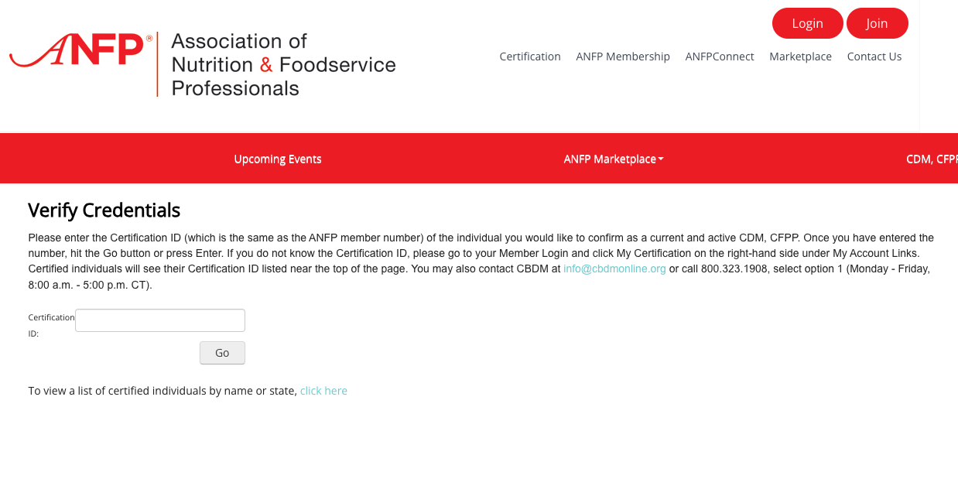
Credential Verification
Employers to verify your credential
Verify the credential of a potential employee

Slide 24

Member Discount Program
Exclusive savings on health insurance, travel, and more with ANFP’s Membership Discount Programs
Gallagher option

Slide 25

Real Foodservice Rewards
Free to ANFP members
Earn free rewards from qualifying food and equipment purchases
Earn and redeem points for ANFP membership dues and CDM, CFPP certification fees

Slide 26

Pride in Foodservice Week
National week dedicated to individuals who work in the foodservice industry
Takes place in February annually
Opportunity to earn ANFP Marketplace credit

Slide 27

Member Appreciation Week
Celebrated each April
Free & discounted CE
Free membership dues drawings
Various prize giveaways

Slide 28

Member & CDM, CFPP Recognition Programs
CDM, CFPP of the Month
What CDM, CFPP Means to Me
Career Reflections
Meet a Member
My Recipe for Success
Early Career CDM, CFPP

Slide 29


NEW! ANFP Mobile App
Free to ANFP members
Features include:
Pay dues
Report CE & upload supporting documentation
Verify credentials
Find CE
ANFP events hub
So much more!

Slide 30
Nutrition & Foodservice Education Foundation
Notes:
Now an update about the Foundation… How many of you are aware of our philanthropic arm, the Nutrition & Foodservice Education Foundation? The Foundation continues to develop new strategies that promote research and education and offers grant opportunities to current and future CDM, CFPPs through the generous donations it receives.

Slide 31


Chapter Champion Program & NFEF Awards

Slide 32

NFEF Donations & Grant Programs Update

Slide 33

Disaster Relief Grant

Slide 34







Corporate Sponsors & Ways to Support
Visionary Level $5,000 - $9,999
Patron Level $1,000 - $4,999

Slide 35
Regulatory

Slide 36
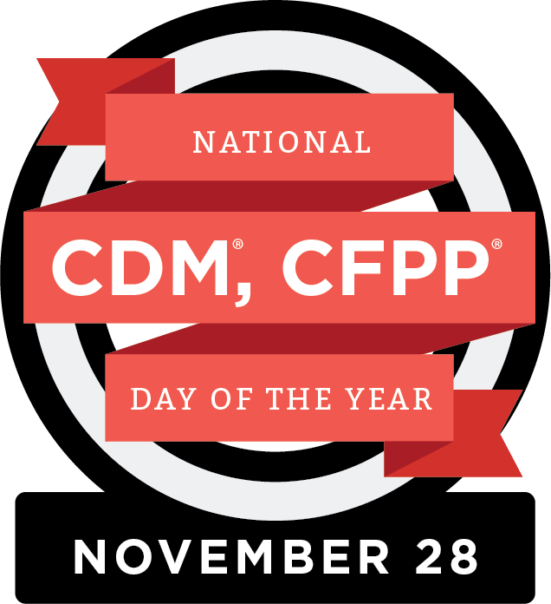
CDM, CFPP Day of the Year – November 28, 2024
Notes:
ANFP continues to celebrate National CDM, CFPP Day of the Year on November 28. This day celebrates the impact that Certified Dietary Managers, Certified Food Protection Professionals have made in the foodservice management profession.
This national day gives ANFP members and their employers the opportunity to recognize the vital work that foodservice professionals perform daily.
We are excited that U.S. Rep. Jen Kiggans (R-VA-2) has made remarks in the Congressional Record since the inaugural celebration, saluting National CDM, CFPP Day and the work done by ANFP’s members, also explaining the CDM, CFPP credential is the basis for the ANFP Apprenticeship Program. Prior to her tenure in Congress, Kiggans worked as a Geriatric Nurse Practitioner in LTC facilities.
Join us as we celebrate and recognize the work of our fellow CDM, CFPPs this coming November!

Slide 37
Legislative

Slide 38
Legislative
Workforce Innovation and Opportunity Act (WIOA)
Apprenticeship Programs
ANFP-PAC

Slide 39

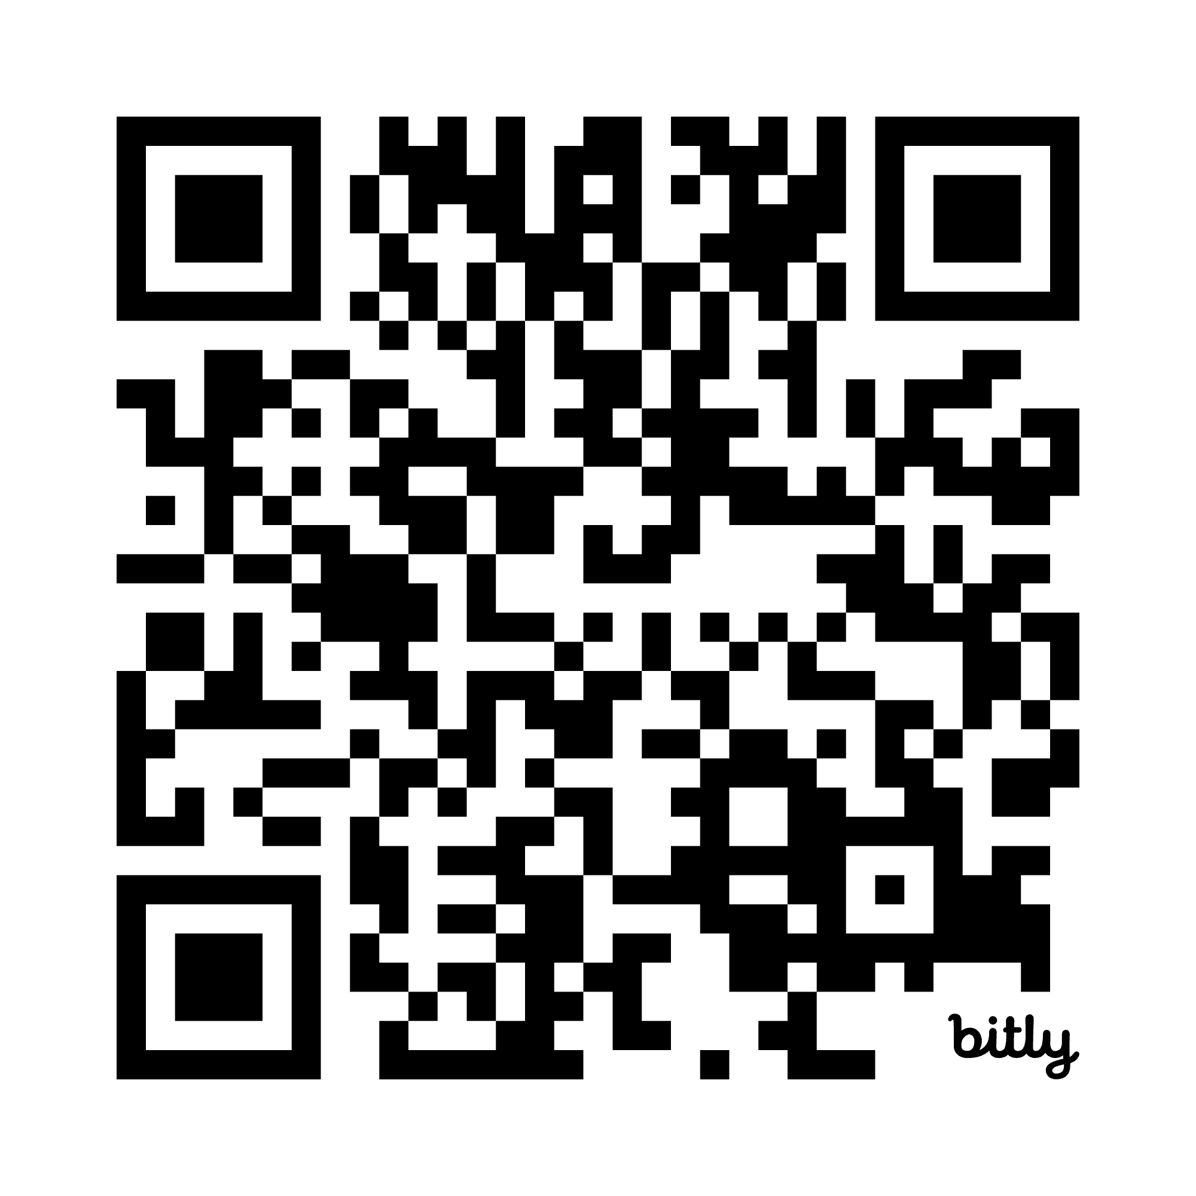

ANFP PAC
Support ANFP-PAC today!

Slide 40
CBDM Certification Program

Slide 41
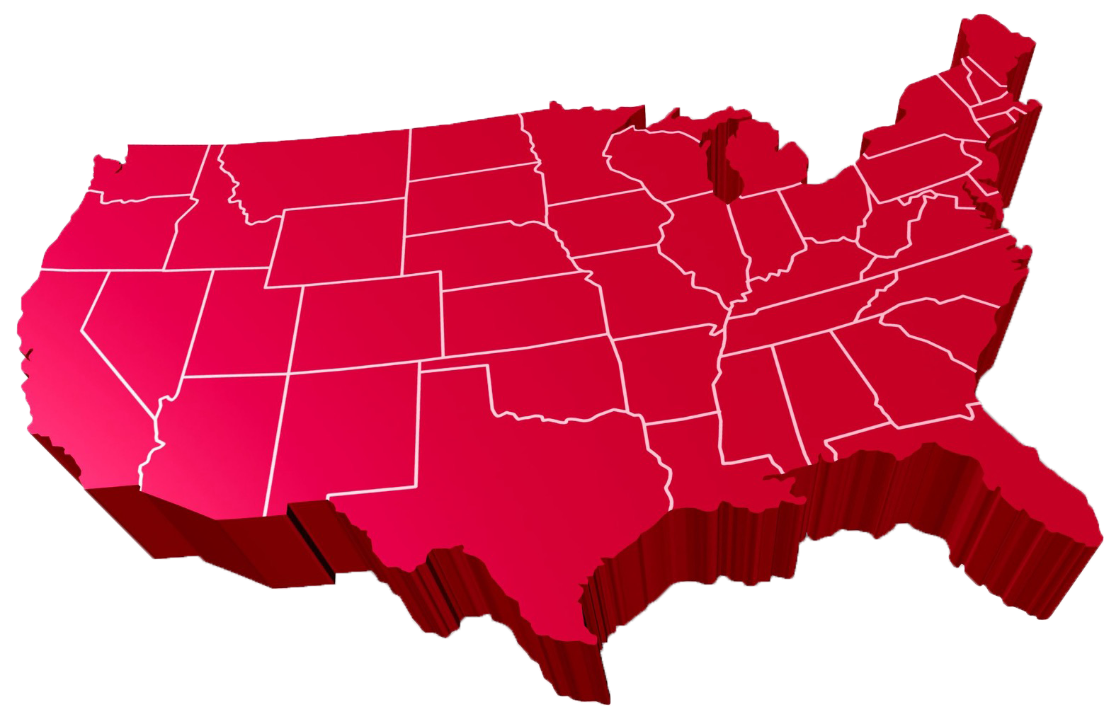
Certification
78%
First-Time
Test Takers
Passing
Rate

Slide 42
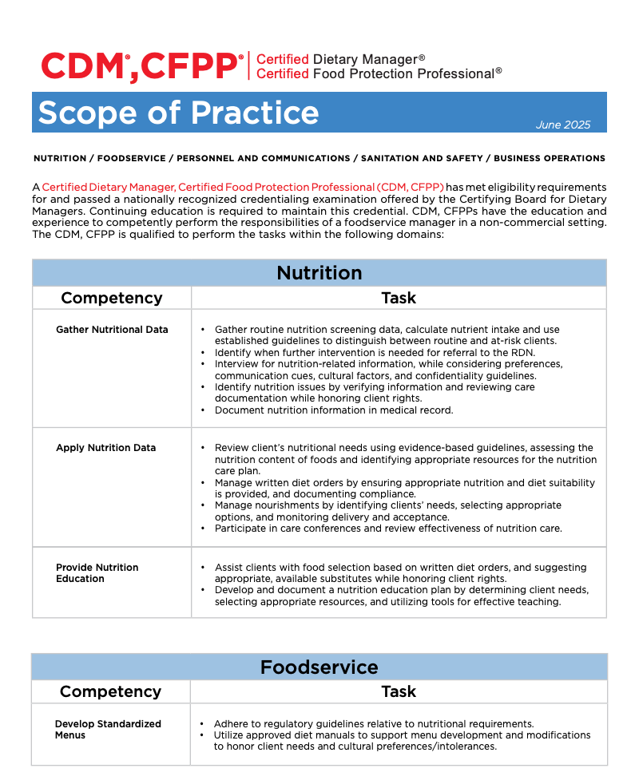
CDM, CFPP Scope of Practice

Slide 43

Continuing Competence Initiative
Embraces demonstrating knowledge, skills or abilities as we progress throughout our careers
Competence means delivering best practice results
Greater credibility with employers, surveyors, colleagues
Encourages looking at our own professional development goals and choosing the right CE to support those needs

Slide 44
CE Audit Update
CDM, CFPPs whose three-year recertification cycle ends on May 31 and have not submitted any CE hours, will have their certification terminated, and will need to retest to become certified again.
CDM, CFPPs with more than 0.5 CE but less than 45.0 CE on May 31of the third year of their recertification cycle, will be automatically placed into CE Audit to remain certified.
All recertification and CE Audit requirements will need to be met to pass the CE Audit

Slide 45
Leadership Transition

Slide 46
Moving Forward
ANFP continues to focus on moving forward in a positive direction
Katherine Church, RDN, has been named Interim President & CEO
We are committed to transparency
More information will be shared with members as it becomes available
Our programs, services, and member support will continue without disruption

Slide 47

Thank You
Phone
800.323.1908
E-mail
info@ANFPonline.org
Website
www.ANFPonline.org

