Slide 1


Update
Experts in foodservice management and food safety

Slide 2



Regulatory

Slide 3
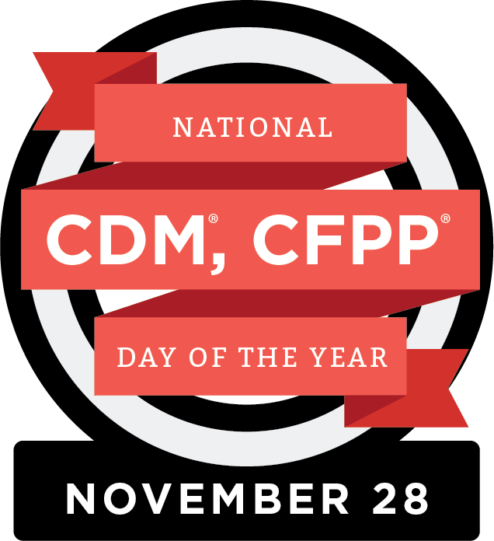
Regulatory
  CDM, CFPP Day of the Year – November 28, 2023

Slide 4
Legislative

Slide 5
Legislative
  Jobs and Careers Coalition
  ANFP Apprenticeship Program
  Status of CMS Regs §483.60 – Food and Nutrition Services
  ANFP Letter to CMS Administrator Brooks-LaSure
  National CDM, CFPP Day of the Year Recognized in Congress

Slide 6
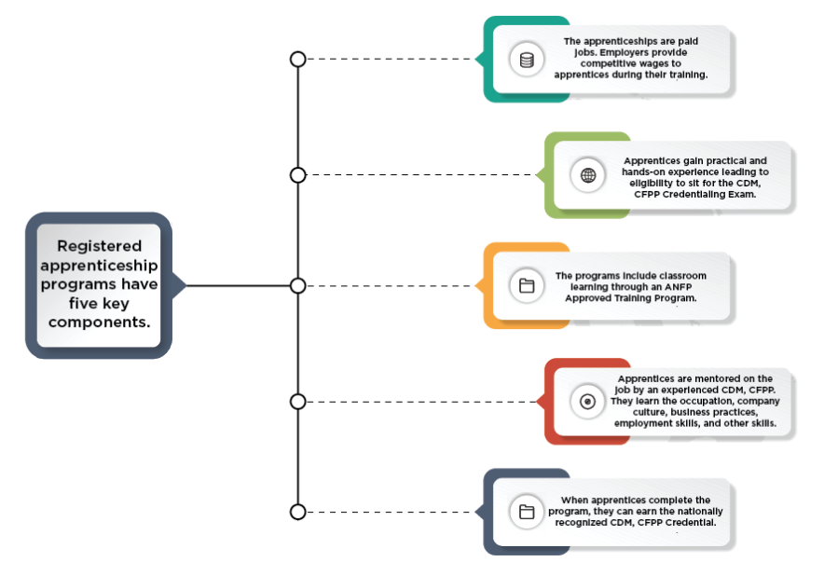
Apprenticeship Program

Slide 7


GrassROOTS Campaign
Rallying Organizations & Officials in Training Standards
Ways to Support ANFP-PAC

Slide 8
CBDM
Certification Program

Slide 9

Certification
76%
First-Time Test Takers Passing Rate

Slide 10
Certification
CDM, CFPP Scope of Practice
www.CBDMonline.org/scope

Slide 11
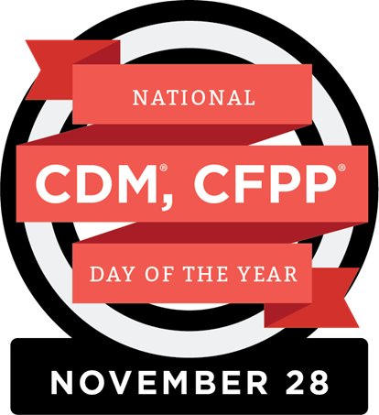
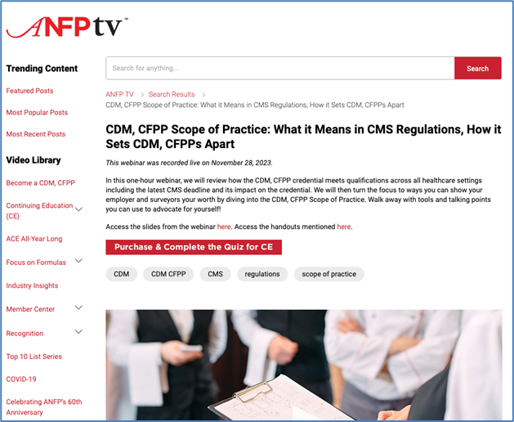
Certification
CDM, CFPP Scope of Practice
www.CBDMonline.org/scope

Slide 12

Continuing Competence Initiative
Certification
Embraces demonstrating knowledge, skills or abilities as we progress throughout our careers
Competence means delivering best practice results
Greater credibility with employers, surveyors, colleagues
Encourages looking at our own professional development goals and choosing the right CE to support those needs

Slide 13
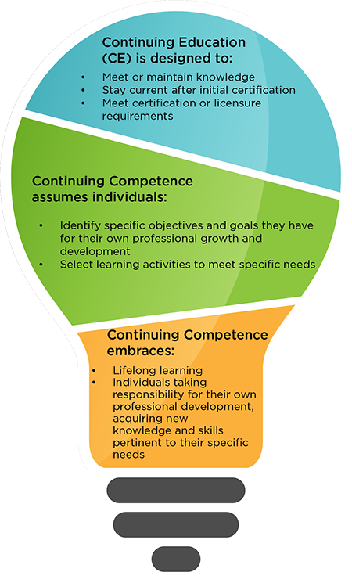
Certification
The Continuing Competence Initiative formally began on June 1, 2023. Participation in the initiative has a rolling start date, to coordinate with your recertification cycle:
Three-Year Recertification Cycle | Start Date
June 1, 2023 – May 31, 2026 | June 1, 2023
June 1, 2024 – May 31, 2027 | June 1, 2024
June 1, 2025 – May 31, 2028 | June 1, 2025

Slide 14
Certification
CE Audit Update
CDM, CFPPs whose three-year recertification cycle ends on May 31 and have not submitted any CE hours, will have their certification terminated, and will need to retest to become certified again.
CDM, CFPPs with more than 0.5 CE but less than 45.0 CE on May 31of the third year of their recertification cycle, will be automatically placed into CE Audit to remain certified.
All recertification and CE Audit requirements will need to be met to pass the CE Audit

Slide 15
Strategic Plan
Update

Slide 16
Strategic Plan
ANFP Vision
Enhance health and wellness through optimum nutritional care.
ANFP Mission
Build an inclusive and diverse community of experts in foodservice management and food safety through:
Education
Advocacy
Research

Slide 17
Strategic Plan
GOAL 1:
Members and prospective members find value, community, and support at the local, state, and national level, resulting in an engaged and growing membership.
GOAL 2:
CDM, CFPPs are recognized as the experts in foodservice management and food safety. The credential is required in regulations and supported by employers and other stakeholders.
GOAL 3:
ANFP is a leader in creating and curating resources to elevate the food and nutrition industry.
GOAL 4:
ANFP is a leader in innovation and continuously evolves to meet the needs of its stakeholders and members.
GOAL 5:
ANFP, as an organization and community, organically fosters a safe environment of diversity, equity and inclusion through the actions of members and stakeholders.

Slide 18
Professional Development

Slide 19
Professional Development
Recertification Bundle
45 hours
Covers all 5 domains
Meets sanitation and ethics requirements
All self-paced learning in new learning management system
NEW COURSE!
The CDM, CFPP Profession: The Foundations of Success
This course is designed to be an overview for those beginning a career in foodservice management as a Certified Dietary Manager, Certified Food Protection Professional (CDM, CFPP).

Slide 20

Professional Development
Learn and Save EVERY Month!
Check out the Discounted CE special page on website for the latest monthly CE specials, free CE opportunities, and the newest offerings to meet your professional development goals.

Slide 21
Membership

Slide 22



Membership
ANFPtv is a member benefit you won’t want to miss!
ANFPtv is a portal within the ANFP website that brings viewers like you fresh, engaging, and educational video content, organized by topic area.
Content ranges from customized education to conference recaps, and much more.

Slide 23



Membership
Recognition Celebrations
Pride in Foodservice Week
Takes place each February
Member Appreciation Week
Takes place each April
Volunteer Appreciation Week
Takes place each Fall
National CDM, CFPP Day of the Year
Takes place each November 28

Slide 24




Membership

Slide 25
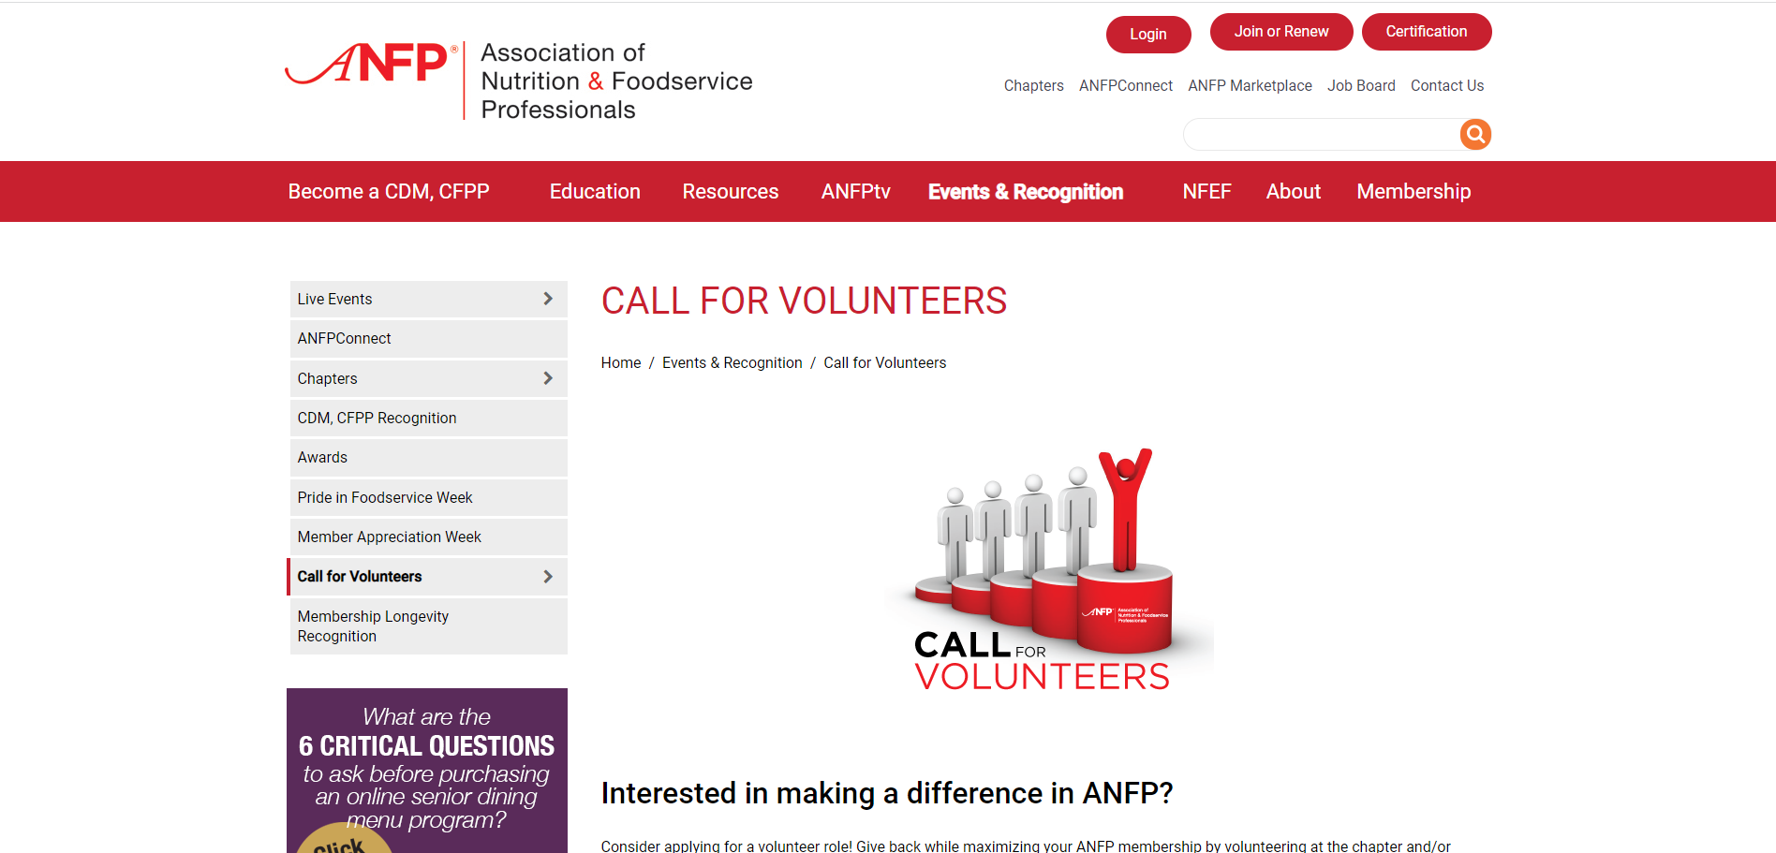
Membership
National & Chapter Volunteers

Slide 26

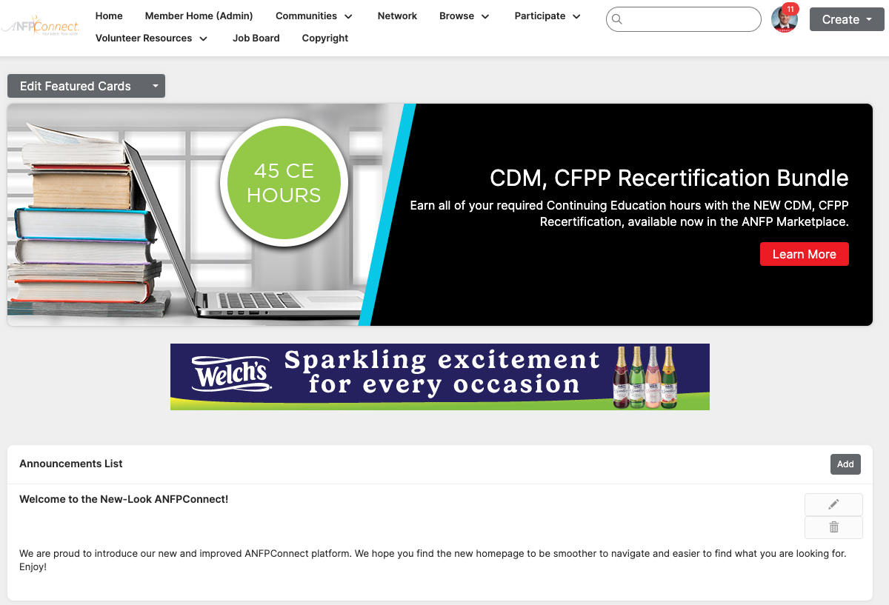

Membership

Slide 27



Membership
Member Discount Program

Slide 28




Member Recognition
Awards & Recognition
ACE Awards
Open to all members
CDM Recognition
CDM of the Month, Meet a Member, Career Reflections, My Recipe for Success
Chapter Awards
Communication, government affairs, membership, state achievement and Diamond awards
Member Longevity Program
ANFP members are recognized for the longevity of their membership

Slide 29

LIG Insurance Program
Health Insurance and coverage options include:
Major medical
Medicare
Short-term health plans
Vision & Dental plans
Critical care coverage & disability
LIG Rx Pharmacy Program & more...

Slide 30
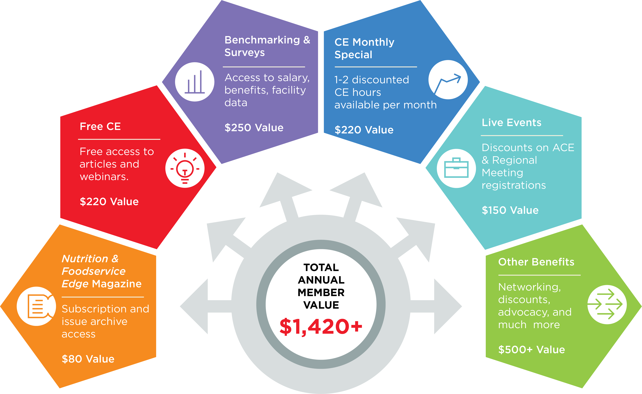
Member Value Infographic

Slide 31
Nutrition & Foodservice Education Foundation (NFEF)

Slide 32


NFEF
Chapter Champions

Slide 33

NFEF
Grants
NFEF is proud to support grant opportunities for nutrition and foodservice professionals and students!

Slide 34






NFEF
Corporate Partners and Ways to Support
Visionary Level $5,000 -$9,999

Slide 35

Thank You
Phone
800.323.1908
E-mail
info@ANFPonline.org
Website
www.ANFPonline.org

