Slide 1


Update
Experts in foodservice management and food safety

Slide 2



Regulatory

Slide 3
Regulatory
CDM Day of the Year – November 28, 2023
NEW ANFP Regulatory and Compliance webpage
2022 FDA Food Code
Government Affairs Committee
Brand Ambassador Guide and Tool Kit

Slide 4
Legislative

Slide 5
Legislative
Status of CMS Regs §483.60–Food and Nutrition Services
Opportunity America Jobs and Careers Coalition

Slide 6
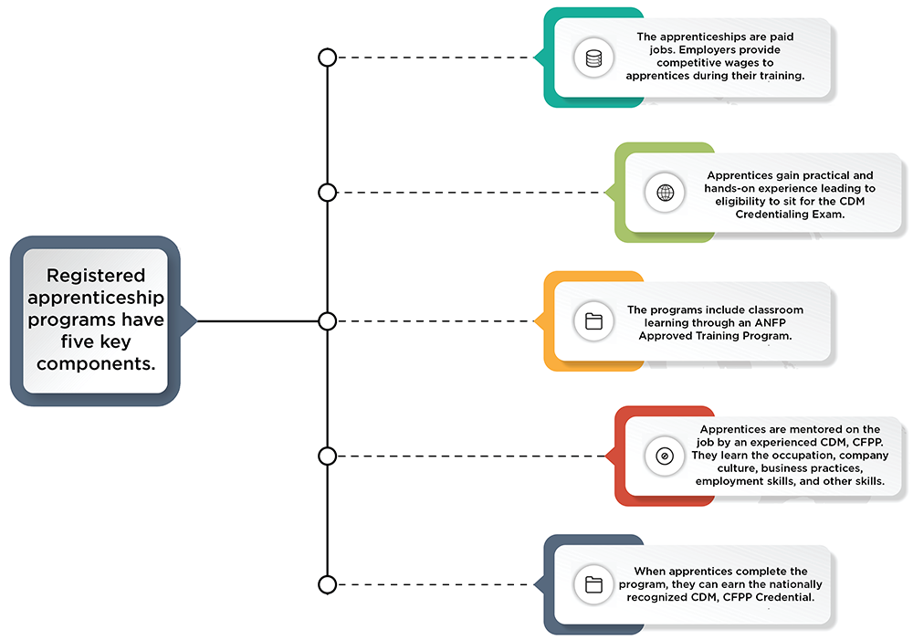
Apprenticeship Program

Slide 7


Government Affairs GrassROOTS Initiative
Rallying Organizations & Officials in Training Standards
Cultivate, Grow, REAP!
ANFP-PAC Contributes to U.S. Senator Bill Cassidy

Slide 8
Certification

Slide 9

Certification
74%
First-Time Test Takers Passing Rate

Slide 10
Certification
CDM, CFPP Scope of Practice
www.CBDMonline.org/scope

Slide 11

Continuing Competence Initiative
Certification
Embraces demonstrating knowledge, skills or abilities as we progress throughout our careers
Competence means delivering best practice results
Greater credibility with employers, surveyors, colleagues
Encourages looking at our own professional development goals and choosing the right CE to support those needs

Slide 12
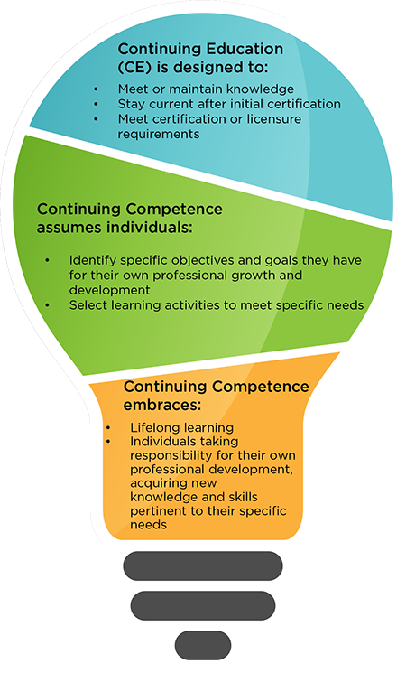
Certification
The Continuing Competence Initiative formally begins on June 1, 2023. Participation in the initiative has a rolling start date, to coordinate with your recertification cycle:
Three-Year Recertification Cycle | Start Date
June 1, 2023 – May 31, 2026 | June 1, 2023
June 1, 2024 – May 31, 2027 | June 1, 2024
June 1, 2025 – May 31, 2028 | June 1, 2025

Slide 13
Strategic Plan Update

Slide 14
Strategic Plan
ANFP Vision: Enhance health and wellness through optimum nutritional care.
ANFP Mission: Build an inclusive and diverse community of experts in foodservice management and food safety through: Education, Advocacy, Research

Slide 15
Strategic Plan
GOAL 1:
Members and prospective members find value, community, and support at the local, state, and national level, resulting in an engaged and growing membership.
GOAL 2:
CDM, CFPPs are recognized as the experts in foodservice management and food safety. The credential is required in regulations and supported by employers and other stakeholders.
GOAL 3:
ANFP is a leader in creating and curating resources to elevate the food and nutrition industry.
GOAL 4:
ANFP is a leader in innovation and continuously evolves to meet the needs of its stakeholders and members.
GOAL 5:
ANFP, as an organization and community, organically fosters a safe environment of diversity, equity and inclusion through the actions of members and stakeholders.

Slide 16
Professional Development

Slide 17
Professional Development
New for 2023!
New Recertification Bundle Released February 2023
45 hours
Covers all 5 domains
Meets sanitation and ethics requirements
Updated online course look and feel
More learning interactions
Easier navigation
Better user experience

Slide 18

Professional Development
Learn and Save EVERY Month!
Check out the Discounted CE special page on website for the latest monthly CE specials, free CE opportunities, and the newest offerings to meet your professional development goals.

Slide 19
Membership

Slide 20



Membership
ANFPtv is a member benefit you won’t want to miss!
ANFPtv is a portal within the ANFP website that brings viewers like you fresh, engaging, and educational video content, organized by topic area.
Content ranges from customized education to conference recaps, and much more.

Slide 21



Membership
New Member Onboarding & Retention
Pride in Foodservice Week
Takes place each February
Member Appreciation Week
Takes place each April
Volunteer Appreciation Week
Takes place each Fall

Slide 22




Membership

Slide 23
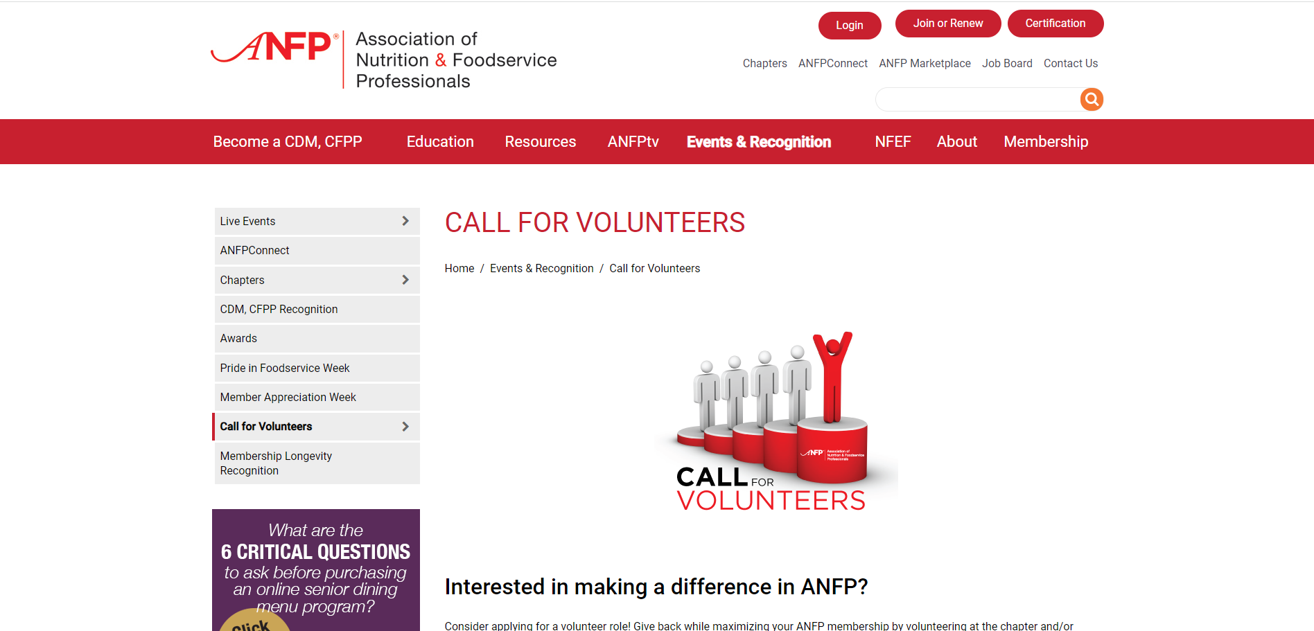
Membership
National & Chapter Volunteers

Slide 24

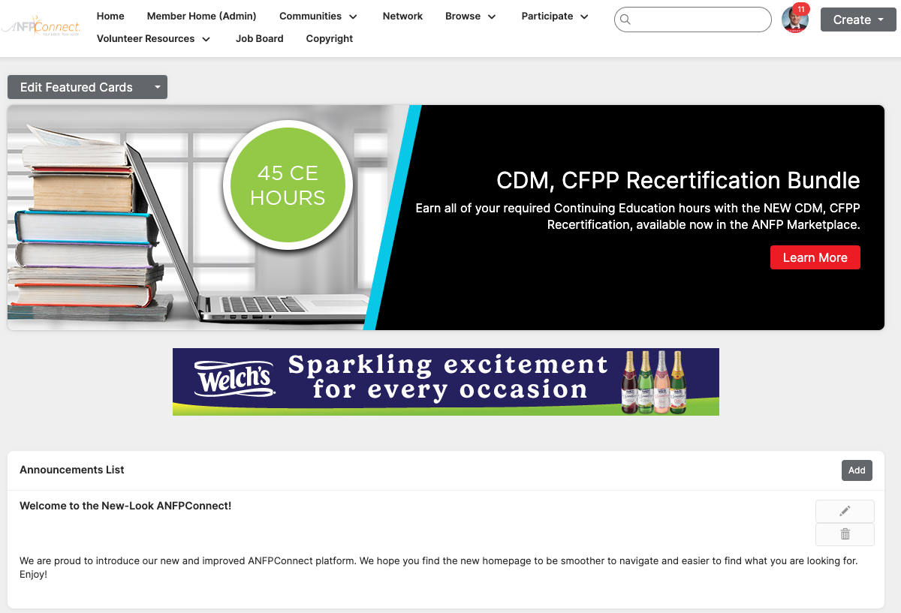

Membership

Slide 25



Membership
Member Discount Program

Slide 26




Member Recognition
Awards & Recognition
ACE Awards
Open to all members
CDM Recognition
CDM of the Month, Meet a Member, Career Reflections, My Recipe for Success
Chapter Awards
Communication, government affairs, membership, state achievement and Diamond awards
Member Longevity Program
ANFP members are recognized for the longevity of their membership

Slide 27

LIG Insurance Program
Health Insurance and coverage options include:
Major medical
Medicare
Short-term health plans
Vision & Dental plans
Critical care coverage & disability
LIG Rx Pharmacy Program & more...

Slide 28
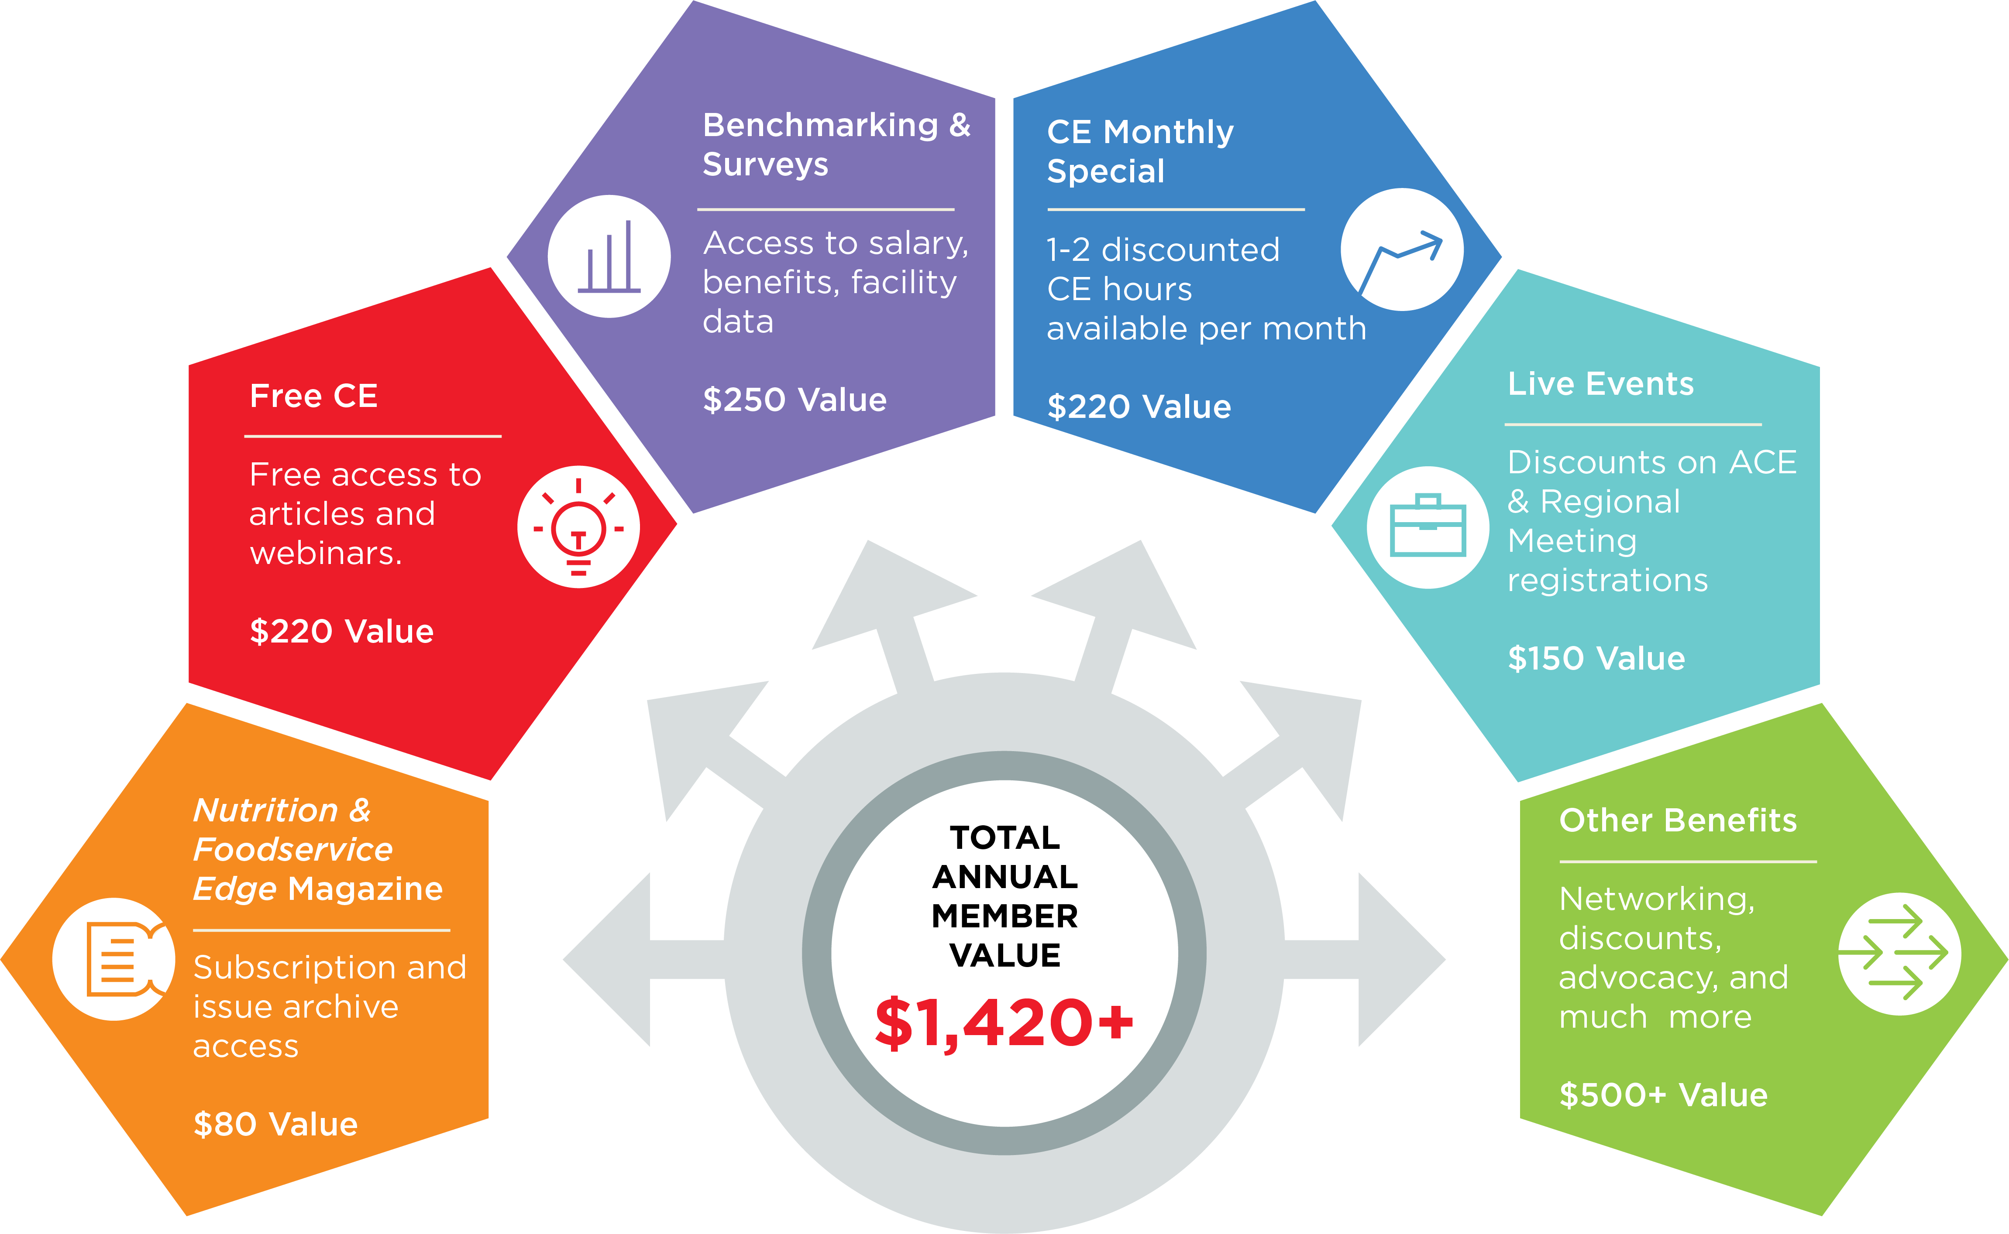
Member Value Infographic

Slide 29
Nutrition & Foodservice Education Foundation (NFEF)

Slide 30


NFEF
Chapter Champions

Slide 31

NFEF
Grants

Slide 32





NFEF
Corporate Partners and Ways to Support
Visionary Level $5,000 -$9,999

Slide 33

Thank You
Phone
800.323.1908
E-mail
info@ANFPonline.org
Website
www.ANFPonline.org

